Slide 1
Charlotte County Q1 2014 Tourism
Presented to:
Charlotte Harbor
Visitor and Convention Bureau
Research Data Services, Inc.
May 1, 2014

Slide 2
Key Visitor Metrics (Jan. – Mar. 2014) (Overnight Visitors Staying in Charlotte County Commercial Lodgings)
Estimated Number of Visitors
113,600 people
Estimated Direct Expenditures
$104,443,800
Total Economic Impact
$159,276,800

Slide 3
Key Visitor Metrics (Jan. – Mar. 2014) (Overnight Visitors Staying in Charlotte County Commercial Lodgings)
Average Immediate Party Size
2.8 people
Average Length of Stay in Charlotte
6.7 nights
Average Party Budget
$2,574.32

Slide 4
Visitor Origin Distribution (Jan. – Mar. 2014)

Slide 5
Smith Travel Research Occupancy
 | Charlotte County
 | Occupancy |  | ADR
 | 2013 | 2014 | 2013 | 2014
January | 49.9% | 63.2% | $78.20 | $86.98
February | 69.1 | 80.5 | 92.28 | 110.59
March | 75.1 | 83.0 | 103.34 | 119.73
Q1 Average | 64.7% | 75.6% | $91.27 | $105.77

Slide 6
Purpose of Trip (Multiple Response)
 | Charlotte Q1 2014 Visitors
Vacation/Getaway | 93.1%
To Visit with Friends/Family | 26.4
Family Events | 11.4
A Golf/Tennis Trip | 10.7
A Fishing Trip | 8.4
A Boating Trip | 5.5
A Kayaking Trip | 4.6

Slide 7
Types of Websites Consulted for Travel Information (Multiple Response)
 | Charlotte Q1 2014 Visitors
Hotel Websites | 54.8%
Destination Sites | 50.8
Review/Rating Sites (i.e., Trip Advisor, Yelp, etc.) | 45.3
Airline Websites | 40.5
Booking Sites (i.e., Travelocity, Expedia, etc.) | 38.4
Mapping Sites (i.e., Map Quest, Google Maps, etc.) | 28.9
Rental Car Websites | 28.6
Restaurant Websites | 26.3
Daily Deal/Coupon Sites (i.e., Groupon, Living Social, etc.) | 17.2
Social Networking Sites (i.e., Facebook, Twitter, Pinterest, etc.) | 16.8

Slide 8
Booked on the Internet for Trip (Prompted)

Slide 9
Charlotte Messaging
Seen/Read/Heard Charlotte Message
44.6%
Influenced (Base: Resp. who saw/read/heard msg.)
74.7%

Slide 10
How Visitors Travel to Charlotte

Slide 11
Airports Deplaned (Visitors who flew)

Slide 12
Repeat Charlotte County Visitation
2.4% of visitors are visiting Florida for the first time.

Slide 13
How First Learn About Charlotte (Multiple Response)
 | Charlotte Q1 2014 Visitors
Recommendation | 65.3%
Internet | 35.6
Brochure/Visitor Guide | 16.3
Magazine/News Story | 9.5

Slide 14
Party Composition (Multiple Response)

Slide 15
Activities Enjoyed in Area (Multiple Response)
 | Charlotte Q1 2014 Visitors
Dining Out | 85.2%
Relaxing | 83.9
Beach | 83.3
Walking on the Beach | 69.0
Pool | 59.2
Swimming | 58.5
Shopping | 55.2
Reading | 54.8
Shelling | 46.4
Visiting with Friends/Relatives | 35.7
Fishing | 29.5
Bars/Nightlife | 16.7
Golfing | 16.5
Boating | 14.9
Spring Training Baseball | 14.3

Slide 16
Satisfaction/Plan to Return
91.7% of Charlotte Q1 2014 visitors plan to return to the area.

Slide 17
Demographics
 | Charlotte Q1 2014 Visitors
Average Age | 53.2 years
Median Household Income | $92,459

Slide 18
Charlotte Comments
Serene, back-to-nature area.
Out-of-ordinary, peaceful, laid-back.
Warm, friendly, affordable.
Golf and dining out.
Sharks’ teeth.
Gorgeous sunsets. Restaurants close by.
Great beach and weather.
Off the beaten path.
Pure, clean beaches.
Uncrowded, unspoiled.
Not overly populated.
Good fishing from the shore.
Best kept secret. I can’t stop bragging about it back home.
Relaxing, non-touristy.

Slide 19
Charlotte Comments
Gulf is beautiful. Beach is nice. Warm weather is wonderful.
Laid back and casual, tropical and fun.
Beach is great. You can walk for miles.
People are very friendly.
Casual lifestyle.
Less rushed.
No high rises.
We had to escape the frigid weather. We needed a tropical, affordable area.
Beautiful nature parks.
Stand-up paddling.
The river affords natural beauty.
Relaxed attitude.
Great place to chill out and relax.
We love the simplicity of it all.
Quaint, feels like old Florida.

Slide 20
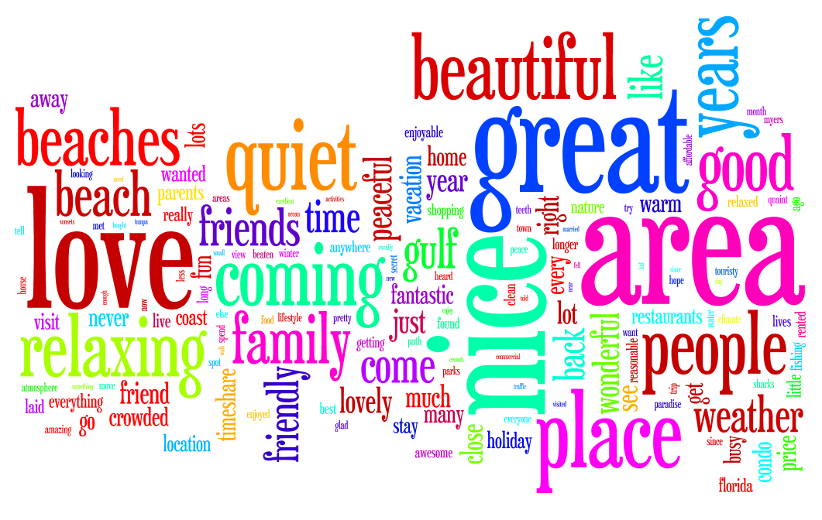
Charlotte Comments

Slide 21
Thank You!!

