Slide 1
Charlotte County 2014 Summer Tourism
Presented to:
Charlotte Harbor
Visitor and Convention Bureau
Research Data Services, Inc.
November 7, 2014

Slide 2
Summer Season April – September 2014

Slide 3
Key Visitor Metrics (Apr. – Sep. 2014) (Overnight Visitors Staying in Charlotte County Commercial Lodgings)
Estimated Number of Visitors
Estimated Direct Expenditures
2013: $112,262,700
Total Economic Impact
2013: $171,200,600
2013: 154,700 people
2014: 178,800 people
2014: $140,297,600
2014: $213,953,800
+15.6%
+25.0%
+25.0%

Slide 4
Key Visitor Metrics (Apr. – Sep. 2014) (Overnight Visitors Staying in Charlotte County Commercial Lodgings)
Average Immediate Party Size
2013: 2.9 people
Average Length of Stay in Charlotte
2013: 6.3 nights
Average Party Budget
2013: $2,104.47
2014: 2.9 people
2014: 6.5 nights
2014: $2,275.52

Slide 5
Visitor Origin Distribution (Apr. – Sep. 2014)

Slide 6
Top Domestic DMA’s (Apr. – Sep. 2014)
 | Rank Order
Tampa/St. Petersburg | 1
Ft. Myers/Naples | 2
Sarasota | 3
Greater Orlando Area | 4
New York | 5
Cleveland | 6
Philadelphia | 7
Boston | 8
Detroit | 9
Atlanta | 10
Pittsburgh | 11

Slide 7
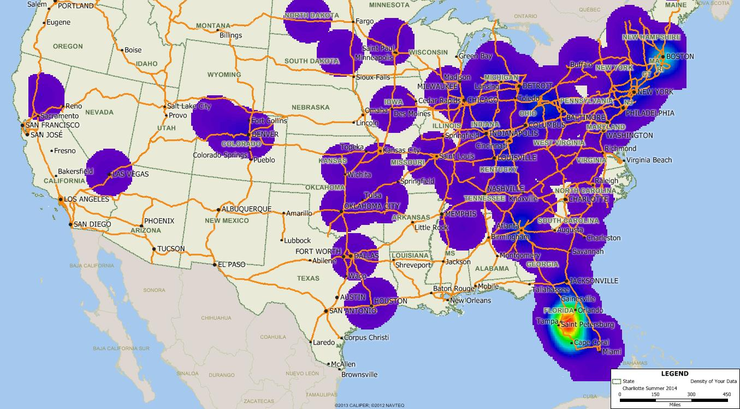
Charlotte Summer 2014 Visitor Zip Code Mapping (Apr. – Sep. 2014)

Slide 8
Smith Travel Research Occupancy
 | Charlotte County
 | Occupancy |  | ADR
 | 2013 * | 2014 | 2013 * | 2014
April | 48.6% | 60.7% | $79.81 | $91.22
May | 43.4 | 52.8 | 73.84 | 80.46
June | 41.7 | 49.6 | 71.77 | 74.16
July | 40.9 | 52.6 | 71.91 | 73.41
August | 42.0 | 50.0 | 73.60 | 75.90
September | 39.7 | 41.4 | 73.15 | 73.87
Apr. - Sep. Average | 42.7% | 51.2% | $74.01 | $78.17
* 2013 Update

Slide 9
Purpose of Trip (Multiple Response)
 | Summer 2013 | Summer 2014
Vacation/Getaway | 94.7% | 91.4%
To Visit with Friends/Family | 24.2 | 27.2
Family Events | 10.4 | 10.1
A Fishing Trip | 10.3 | 9.2
Special Event | N/A | 7.9
A Boating Trip | 7.2 | 5.9

Slide 10
Types of Websites Consulted for Travel Information (Multiple Response)
 | Summer 2013 | Summer 2014
Destination Sites | 46.2% | 44.7%
Hotel Websites | 43.3 | 42.5
Review/Rating Sites (i.e., Trip Advisor, Yelp, etc.) | 37.8 | 39.4
Airline Websites | 39.5 | 36.6
Restaurant Websites | 35.7 | 35.3
Booking Sites (i.e., Travelocity, Expedia, etc.) | 36.3 | 33.4
Mapping Sites (i.e., Map Quest, Google Maps, etc.) | 33.9 | 28.9
Rental Car Websites | 27.3 | 24.7
Social Networking Sites (i.e., Facebook, Twitter, Pinterest, etc.) | 17.2 | 20.7
Daily Deal/Coupon Sites (i.e., Groupon, Living Social, etc.) | 16.2 | 17.4

Slide 11
Booked on the Internet for Trip (Prompted)

Slide 12
Charlotte Messaging
Seen/Read/Heard Charlotte Message
35.6%
Influenced (Base: Resp. who saw/read/heard msg.)
77.2%

Slide 13
How Visitors Travel to Charlotte

Slide 14
Airports Deplaned (Visitors who flew)

Slide 15
Repeat Charlotte County Visitation
2.4% of Summer 2014 visitors are visiting Florida for the first time.

Slide 16
How First Learn About Charlotte (Multiple Response)
 | Summer 2013 | Summer 2014
Recommendation | 57.0% | 63.3%
Internet | 35.9 | 35.3
Brochure/Visitor Guide | 12.3 | 13.1
Magazine/News Story | 11.9 | 9.4

Slide 17
Type of Lodging Used

Slide 18
Party Composition (Multiple Response)

Slide 19
Activities Enjoyed in Area (Multiple Response)
 | Summer 2013 | Summer 2014
Beach | 90.7% | 89.6%
Dining Out | 77.5 | 81.9
Relaxing | 78.5 | 79.3
Swimming | 76.8 | 74.0
Walking on the Beach | 70.6 | 71.9
Pool | 64.4 | 59.3
Reading | 57.8 | 55.4
Shopping | 52.6 | 54.0
Shelling | 51.4 | 51.0
Visiting with Friends/Relatives | 33.8 | 36.4
Fishing | 36.6 | 34.3
Bars/Nightlife | N/A | 28.8

Slide 20
Satisfaction/Plan to Return
92.4% of Summer 2014 visitors plan to return to the area (Summer 2013: 89.4%).

Slide 21
Demographics
 | Summer 2013 | Summer 2014
Average Age | 51.7 years | 52.2 years
Median Household Income | $86,937 | $91,743

Slide 22
Charlotte Comments
So pretty. Great restaurants and shops.
There's no place like Punta Gorda. Very safe here.
Beautiful old Florida charm. Quaint.
It's a great little town: clean and friendly.
Best beaches in the world.
Nice area, calm, quiet, exotic.
Good water access.
Great family location, lots to do.
Wonderful, beautiful, affordable place.
I already put it on Facebook.
Quiet, secluded, like seeing manatees.
Color of water is fabulous. Nice getaway from everything.
Relaxing place to decompress.
Lots of pretty shells.
Magical million dollar sunsets.

Slide 23
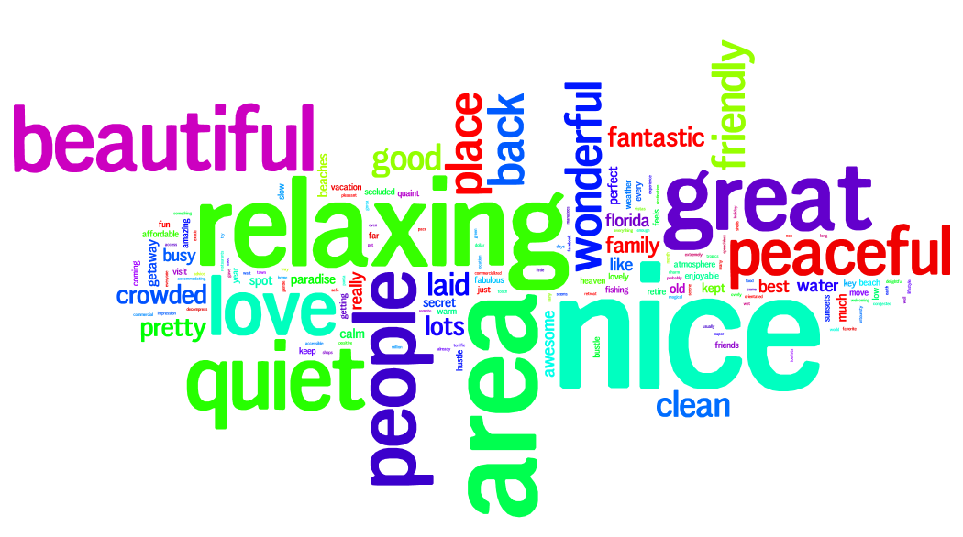
Charlotte Comments

Slide 24
Thank You!!

