Slide 1
Long-haul Markets
Seminar 27.September

Slide 2
Seminar about Long-haul Markets
Why are they important?

Slide 3
Notes:
Where we are present/do activities

Slide 4
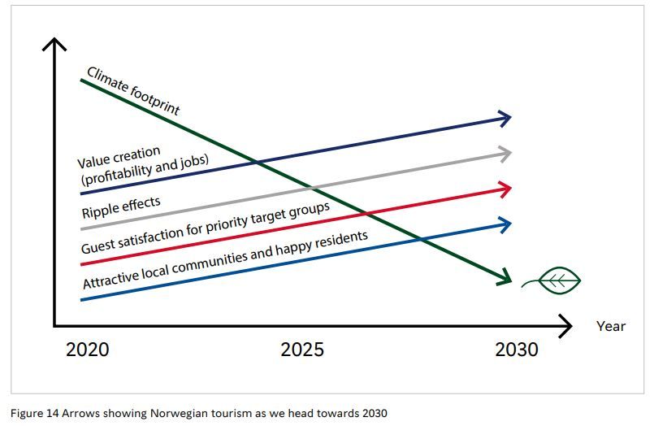
National Tourism Strategy 2030
“The strategy must help to reduce our carbon footprint, create jobs, enhance value creation, increase add-on sales, enhance visitor satisfaction and have a positive impact on local communities” (p53)
Notes:
calculate how to offset the footprints of the tourists. Dine in local restaurants, purchase local products, collect garbage and recycle bottles during trip, using public transportations, longer stay in each places, visit less developed areas, offseason travelling, donate into sustainable funds, purchase eco-friendly travel products, etc. We could design so many activities to promote them among tourists to help them to offset their cardon footprints to achieve the tradeoff. This is a complete ecosystem and everybody could contribute into the great cause. There should be no discrimination between nearby markets and faraway markets, there should be only difference on how people traveled.

Slide 5
Source: The Tourism Survey 2019

Slide 6
Source: The Tourism Survey 2019

Slide 7
Visitor Statistics 2021 vs 2021

Slide 8
Foreign guestnights per month 2019 Long-haul 2018
16% 15 % 17% 20% 30% 24% 20% 23 % 35% 32 % 27% 25%
Kilde: SSB

Slide 9
Long-haul markets split (from last picture)
Kilde: SSB

Slide 10
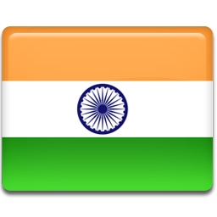
Holiday periods
JANUARY
FEBRUARY
MARCH
APRIL
MAY
JUNE
JULY
AUGUST
SEPTEMBER
OCTOBER
NOVEMBER
DECEMBER

Slide 11
Long-haul visitor arrivals to Europe Index 2019 =100

Slide 12
Top Long-haul source markets Source market’s share of all arrivals to Europe

Slide 13
Main incentives to visit Europe

Slide 14
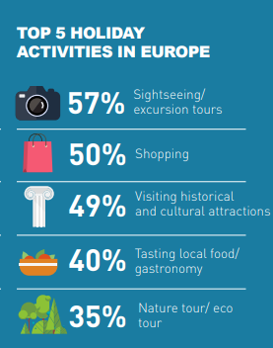
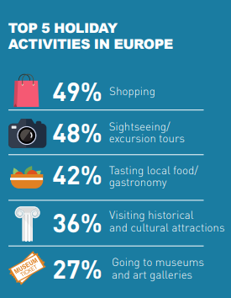
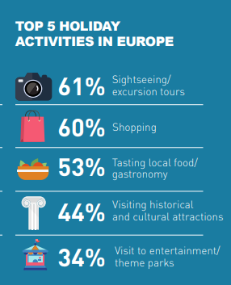
Preferred activities

Slide 15
Notes:
Overturisme – sightseeing to landmarks:
Tenk – hva vil DU se når du reiser langt? Du vil se den kinesiske mur når du drar til Kina, eller Matchu Picchu i Peru. Fyrtårnene

Slide 17
Average length of stay

Slide 18
Average consumption (USD per night)

Slide 19
National Tourism Strategy 2030
Notes:
VisitNorway as tourist board could lead the building of the “Sustainability Calculator” to guide people what to do to reduce their cardon footprint and set up the relevant standard to qualify the sustainable products from Norway such as guide local incoming agencies and activities companies to design cardon-neutral even cardon-negative products, which will eventually benefit the tourists from all over the world but also achieve the target of sustainability if you also put economic aspects into account.

Slide 20
Long-haul markets and Sustainability
Skift article, 17th of August by Peden Doma Bhutia
Notes:
Gjester fra disse markedene vil uansett finne veien til Norge. Viktig med tilstedeværelse, slik at vi- sammen med incoming bransjen – påvirker salgsleddene ute i markedene til å ta riktige valg og beslutninger, samt vite våre «krav» til gjester som skal besøke Norge.

Slide 21
Booking patterns
Younger generations
Internett, online travel agents
55+
Book via travel agents/tour operators
Notes:
Physical presence in the markets – B2B events
These markets book via TO. Younger travellers use OTO/OTAs

Slide 22
Our presence /work in the markets
STB
USA – own office based in NY
China – STB office with 3 employees
India – Retail agreement with STB+Sweden
Brazil/South America – annual agreement GVA
Japan/Korea/Thailand/Indonesia – ad hoc hours with previous retail agents
Singapore – buying tourism hours from IN
Scandinavian Tourist Board
Originally an organisation with all 3 Scandinavian countries.
Now only VisitDenmark and IN Tourism is part of the organisation, while Sweden buy in ad hoc
Owns office in China with 3 employees
Contracted Compass Connextions in India

Slide 23
Our activities
Shopping chart: do not need to attend all markets, select the markets you prioritize – but on the same tour (when first travelling the long flight overseas).
Also time to make sales calls in addition to the VN B2B events
Every other year overseas enough
Consider digital vs physical every other year
The year when not travelling – invite trade to Norway on fam trips to the regions/suppliers who work on these markets
Australia has been on our radar for years..
Depending on budget and prioritations

Slide 24
In-depth info from the different markets

Slide 25
@ETC

Slide 26
@ETC

Slide 27
More info: China

Slide 29
China
McKinsey:
outbound leisure travel will likely be slow to return.
To travel internationally, the Chinese consumer wants to see close to zero COVID-19 cases in the destination country (86 percent rated this as a top 3 factor).
The second most important factor for Chinese travelers is the removal of quarantine in China upon return (84 percent).
McKinsey “outlook for China tourism 2022”
FOTO: Ingunn Sakshaug

Slide 30
China
visiting cultural or historical sites has increased from 39 percent to 44 percent
Outdoor scenic destinations remain the most popular
Emotional satisfaction is becoming increasingly important
travelers wish to learn something new or have a transformative personal experience during their leisure trips.
McKinsey “outlook for China tourism 2022”

Slide 31
China
The market is diverse:
High end consumers are willing to pay for the extraordinaire experiences and services. But they have to see it is worth spending more money on.
Mid class consumers are looking for best value – the price is not most essential when it comes to the decision fase, but they do look for good bargains
The volum market is there, and is still huge. But the quality is not the same as before.
FOTO: Ingunn Sakshaug

Slide 32
More info: India

Slide 33
Holiday Periods
Winter festive season is mostly between October - early January.
Schools are closed for two weeks around October / November and later closed for about 10 days around Christmas. Often family vacations are planned in this period.
November to January is also considered auspicious for weddings and hence honeymoon or romantic getaways for anniversary celebrations is at its peak.
Summer breaks are between April - June for most schools, however there has been a significant rise in international schools in India and the summer vacations for these schools are in the month of July and August.

Slide 34
Travel Trends
One of the biggest trends that has been witnessed in India is increased spendings by travellers, for example they are willing to pay for a higher category room or an experience that might be worth it.
Increased length of overall vacation, leading to increased overnights in each city
Enhanced level of personalisation and research
Private coach for small groups of friends and family has seen increase in demand
Preference for going beyond the large cities - nature, wellness, health cuisine
Indian travellers have shown some inclination towards responsible & green travel

Slide 35
Nights spent – and what do they want to experience?
Most Indians visit Europe or Scandinavia for 2 weeks on an average
Travel to Norway as a solo country averages between 7-10 days
what do they wish to experience (spending money on shopping/activities etc)
Indian travellers visit Norway for its natural beauty, equally for its modernity and quality of life.
Indian travellers would mostly like at least one organised tour or an authentic activity each day. This would include the typical must-do’s in each city - attractions, museum, boat ride, and a city orientation tour. Younger generation love authentic experiences including cuisine.
Day trips to nearby locations or beautiful towns / villages that are well connected on public transportation or while they self-drive.
Most Indian travellers are compulsive shoppers and will consume from luxury goods to locally produced products or souvenirs, packaged food such as cheese, charcuterie, chocolates or alcohol, etc.

Slide 36
Travel Patterns
Booking methods
Do they include many countries while on tour, or mono/duo destinations?
Indian travellers prefer to combine the three Scandinavian countries and sometimes also Finland.
Small percentage of Indian leisure travellers, especially repeat travellers are often now seen planning a solo country visits.
Norway vs similar countries (Finland, Canada, Switzerland) – what is our potential?
Norway is extremely potential as it offers unmatched Nature, Fjords, Midnight Sun, Northern Lights [at moderate winter temperatures], and its cool capital Oslo.
Finland has direct connectivity advantage however it also makes the rest of Scandinavia an easy access. It has also marketed the Santa Claus and Christmas over the last 15 years.
Most travellers who visit Finland or Canada will eventually visit Norway or vice versa.
Switzerland has a tremendous branding & marketing advantage and one of the first European countries to position themselves as the most beautiful country to visit. They have also been successful to have repeat visitors from India.
Above 90% Indian travellers to Scandinavia book via tour operators.
Online travel companies such as makemytrip.com | yatra.com | pickyourtrail.com facilitate offline bookings. Less than 2% holidays to Scandinavia are booked online.
However, a slightly higher percentage of hotel reservations are being made online after several consultations from multiple travel companies for location or quality.

Slide 37
Other
Scandinavia’s proximity to India on a direct flight is on an average 7-8 hours as compared to the other Asian countries which is approx. 12 hours. Hence we are not exactly long-haul by the new parameters
Finland, Canada, Switzerland, France, Spain, Italy Invest significantly more than Norway in engaging with the travel trade & media on accounts of familiarisation visits, social media campaigns, destination branding, etc.
Strategy for India should be to attract travelers with potential to stay longer, consume locally and enjoy authentic experiences. Most importantly our strategy for the next three years should be to attract repeat travellers from India, as we have often seen they are both more immersive and responsible.

Slide 38
More info: Japan

Slide 40
Travel Trends
Booking methods
From group travel to individual travel; from ordinary sightseeing to purpose-led programs; from roundtrips to staying in single destinations
dynamic packaging by using OTAs;
services for solo travelers; outdoor activities for families; self-driving tours; farms stays and rural experiences; "workation" programs; sustainable tourism programs becoming more popular
Experiencing historical and cultural attractions (80%)
experiencing natural and scenic attractions (75%)
art galleries and museums (65%)
shopping (55%)
gourmet sampling (48%)
Internet (63%)
travel agents/tour operators (17%)
mail order/telephone (8%).
Booking via the internet is now the dominant method; both home-grown and international OTAs are becoming more and more important as a point of purchase, many Japanese travelers book via internet sites of trusted tour operators

Slide 41
Travel patterns
Post-pandemic desire for nature-based destinations/avoiding crowds puts Norway in a good position. The desire to stay in one destination and do various activities without a lot of traveling is also becoming stronger and Norway is also a good position to offer such services/experiences. However, accessibility (lack of direct flights) is a bottleneck for growth
The buzz within the trade these days is that days of cheap, mass group tours are over; for long-haul destinations, the marketing focus should be on the affluent sector. Although behind other markets, sustainability is also growing in importance. The Hawaiians and Canadians are trying to take the leading position in Japan. They have gone beyond "sustainable tourism" to "regenerative tourism". Norway should also try to take a position in this space by offering innovative ways for tourists to contribute to regenerative tourism.

Slide 42
Nordisk presentation at NTC 15.sept

Slide 43
Nordisk presentation at NTC 15.sept

Slide 44
Nordisk presentation at NTC 15.sept

Slide 45
Nordisk presentation at NTC 15.sept

Slide 46
Nordisk presentation at NTC 15.sept

Slide 47
Nordisk presentation at NTC 15.sept
Notes:
Re-grouping:
Larger companies – due to the governental support – able to keep their staff, doing other work tasks
But many have left the industry as well, so a lot of knowledge is lost

Slide 48
Finnair presentation at NTC 15.sept

Slide 49
Finnair presentation at NTC 15.sept

Slide 50
More info: South-Korea

Slide 51
Holiday periods
January – lunar calendar new year so they use these occasion using year end
February – March when school has their spring holidays
July – August it is really summer vacation including National holidays 15 August.
September – Lunar Full Moon, all those days, give one day off more days, which makes longer weekends. .
October is the season for travelling using national holidays both October 3/National day and Oct 9 Korea Alphabet days
Most of general people use national holidays
November is for middle age group
December also for 50 – 60 group during Christmas season and looking for New Year’s holidays.
Most of the Korean has no limit to holiday season for their own holidays.
Students are exempted for their own holidays as an official studying days.
There are most of the people are using their long weekends as long haul vacation.
For short period
People are considering Friday afternoon and return on Monday morning, for short haul vacation.
Some of office officials use their weekdays using the weekend.

Slide 52
Travel trends
Many Korean explore the market after long silence, and first choice is East Asia market, and Europe is the 2nd choice and Canada/USA follows afterwards.
Spain, Greece organized Charter flights after July 2022.
- How many nights do they spend when travelling to Europe/Scandinavia/Norway
For vacation using weekend – 6 – 8 days
For long distance destination usually 12 – 15 days who has time
What do they wish to experience (spending money on shopping/activities etc)
Something unique like museum and other cultural items.
Shopping is a must item whenever they travel, specially in Norway Health care medicine or local products like food (cheese etc) plus some clothes, which were introduced in Korea via internet or TV..
Mostly they prefer just relaxing and experience something different but not in Hurry, specially during Pandemic.
For activities, they prefer relaxing thru the beautiful scenery.

Slide 53
Travel patterns
Booking methods (travel agents/tour operators, internet)
Do they include many countries while on tour, or mono/duo destinations?
Lately they prefer two or three countries only or maybe one country if the connection is available
Norway vs similar countries
Norway is becoming additional destination with more like Sweden or Denmark (due to flights).
There is no direct flights, they have to use one stopover on the way, due to flight situation, Norway can be the 2nd point to travel… via KLM, LH, BA or Turkish Airlines.
Lately Iceland is becoming very popular but depend on how the flights offers.
As they can visit Iceland via Norway.
Notice Finnair has frequent flights (from November more flights and also launching Busan- Finland flight) but not many people stay in Finland
But they use Silja line to save one night accommodation. So it depends on arrival time in Finland, which makes 2nd destination to arrive Norway.
There are 2 kinds of people:
For young generation, they do by themselves through internet.
Other group use travel agents as they provide rather cheap airfare (due to group fare they got cheaper than outside individual. )
Free travelers They use airline promotion when they use certain period to provide promotional fare. They decide destination whenever destination was introduced what they would like to visit. They book well in advance.

Slide 54
More info: Thailand

Slide 55
Holiday periods
All year!
Core period (or we call it the busiest period)
around March to October which is Spring, summer, and autumn (to Europa/Scandinavia)
Winter period
Thai tourists are beginning to become increasingly interested in this time period, especially the group that takes interest in traveling to Norway that presents the exotic destinations continuously
Perfect for Gen Z travellers that loves adventure activities, Ice hotel and/or chasing Aurora especially in Norway.
The most popular destinations are Lofoten , Tromso, Alta, There are plenty of Agents that plans the trip from Dec to March frequently
@Terje Rakke

Slide 56
Travel trends - Thai
Generation | Age | Travel preferences | Hospitality preferences | Influencers | Changes after Covid | Example of activities
Generation Z | <24 years old (born after 1995) | Open-mined, bucket-list oriented, love adventure and eco-travel, love nightlife | Non-traditional hotels, eco-hotels | Social media | Less fear, ready to travel with fun (short-term), tight budget | - Visit an amusement park - Nightlife - Hiking - Meeting Influencers/Artists/Celebrities by attending events, concerts, Sports matches, etc. - Discover new destinations - Approach new culture with Local - Eco-tourism - Sightseeing
Generation Y (or Millennials) | 24-37 years old (born between 1981-1994) | Travel Solo or in pairs with a friend, visit family, prefer all-inclusive, relaxing, and romantic gateways and sport | Smaller boutique brands, shared economy (AirBnB) | Advertisement | Less fear, short-term travel, respond to travel campaigns
Generation X | 38-53 years old (born between 1965-1980) | Focus on experiences, travel less frequently than other generations, family trips, sports, business trip | Resort, family hotel, business trips | Tour groups, search engine tools | Fearful, limit big spending, limit business trips | - Sightseeing - Watch favourite sports game/ match - Food hunting - Nightlife - Hiking
Baby-boomers | 54-72 years old (born between 1946-1964) | Focus on relaxed and non-adventure trips, big spend | Upscale, family hotel, traditional hotel concepts | Tour groups, word of mouth | Fearful, somewhat limit travel | - Sightseeing - Visit historical or religious places - Food hunting - Follow other family members activities
Silver-hair generation | >72 years (born before 1946) | Large group travel (More than 4 people), deep pocket, long vacations, big spend | Upscale, traditional hotel concepts | Tour groups, word of mouth, family | Fearful, limit travel | - Sightseeing - Visit historical or religious places - Going to the Casino, cruise

Slide 57
@ETC

Slide 58
Travel trends - Thai
Booking methods (travel agents/tour operators, internet)
Average number of nights spent in Europe is 6.7 nights
Rise of the ‘second city’ traveler
Exploration of lesser known destinations in a bid to reduce over-tourism and protect the environment, will take a leap forward
Tech-spect the unexpected
Key aspects of travelers decision-making even more firmly in the hands of technology
Slo-Mo is the new #FOMO
Instead of experiencing the constant fear of missing out (FOMO), travel in 2020 will be all about taking it slow
Discovering the all amusive escape
Rise in travelers exploring the ‘all amusive’, by visiting destinations that offer an array of enriching experiences and attractions
Traditional Travel Agent – 15% (Travelers that comes in groups would mostly book with Traditional Travel Agencies and very few for individual traveler or two.)
Airline Agent – 35% (Travelers find it convenient and safe to book through an airline agency. Most of the travelers are either individuals or business travelers.)
Online Travel Agency – 50% (Groups of families or single travelers make reservations using online travel agencies to locate affordable accommodation, deals, and the ability to select all the features they require.)

Slide 59
@ETC

Slide 60
Norway vs similar destinations - Thai
Number of travelers
(in thousands)
Apx. stay duration
Expenditure per person (USD)

Slide 61
More info: Singapore

Slide 63
More info: Indonesia

Slide 65
More info: Brazil

Slide 67
From the Research & Analysis report made by GVA, of the current situation of Tour Operators & Travel Agencies in Brazil and LATAM

Slide 68
From the Research & Analysis report made by GVA, of the current situation of Tour Operators & Travel Agencies in Brazil and LATAM

Slide 69
From the Research & Analysis report made by GVA, of the current situation of Tour Operators & Travel Agencies in Brazil and LATAM

Slide 70
More info: USA

