Slide 1
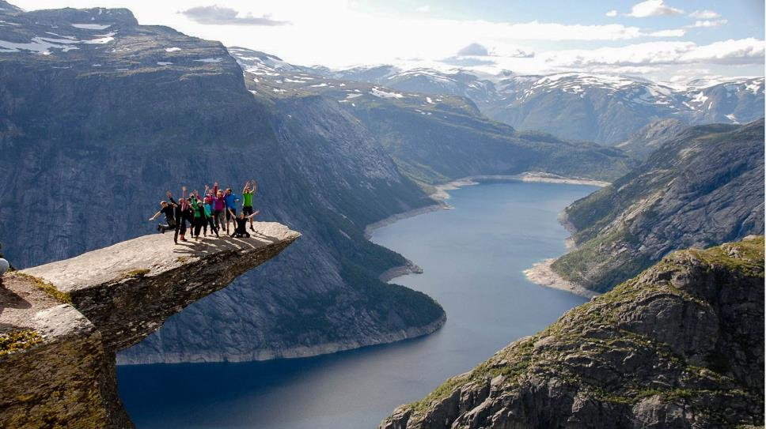
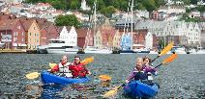
STEP OUT OF YOUR COMFORT ZONE
BERGEN
AND THE FJORDS

Slide 2
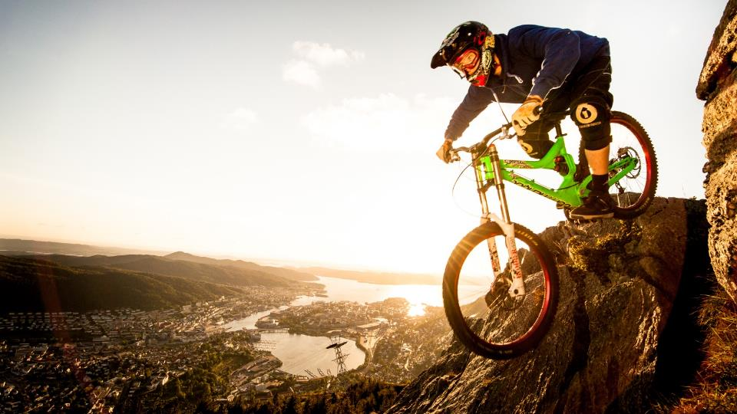
BERGEN
The Gateway to the Fjords of Norway
World Heritage City
European City of Culture
Gastronomy city in UNESCO's Creative Cities Network

Slide 3
EASY TO GET TO!

Slide 4
NEW TERMIAL AUGUST 2017
DIRECT FLIGHTS FROM
Copenhagen
Amsterdam
Paris
Berlin
London
Stockholm
New York
OSLO – BERGEN
32 Daily arrivals

Slide 5
HOTEL BOOM
45 HOTELS – 7.500 ROOMS
15.000 BEDS

Slide 6
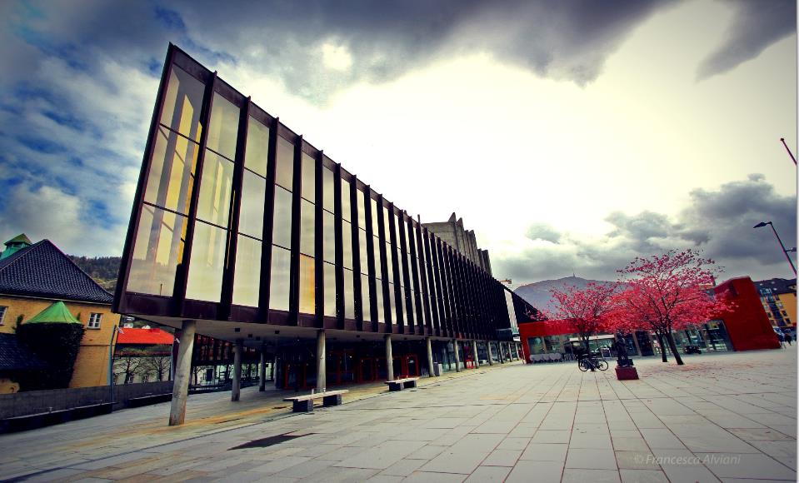
MODEREN & PROFESSIONAL MEETING SPACE & CONFERENCE HALLS FOR UP TO 2.200 PEOPLE

Slide 7
UNIQUE VENUES
HISTORICAL VENUES
UNIQUE VENUES
EXTREME CHALLENGES

Slide 8
City of Bergen - Gastronomy city in UNESCO's Creative Cities Network
UNESCO

Slide 9
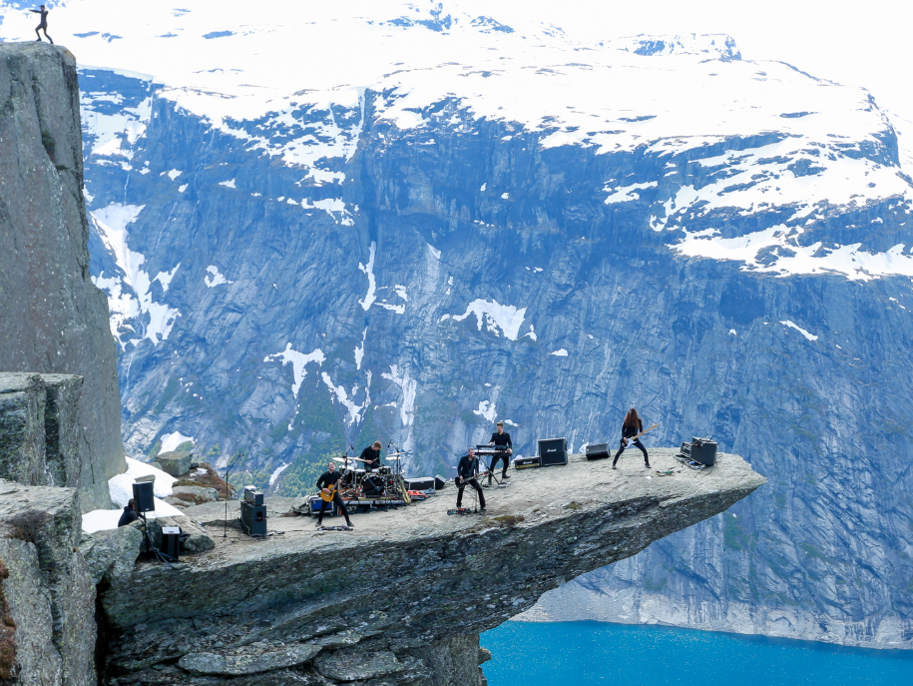
FJORD ACTIVITIES
EXPERIENCES OUTSIDE YOUR COMFORT ZONE

Slide 10
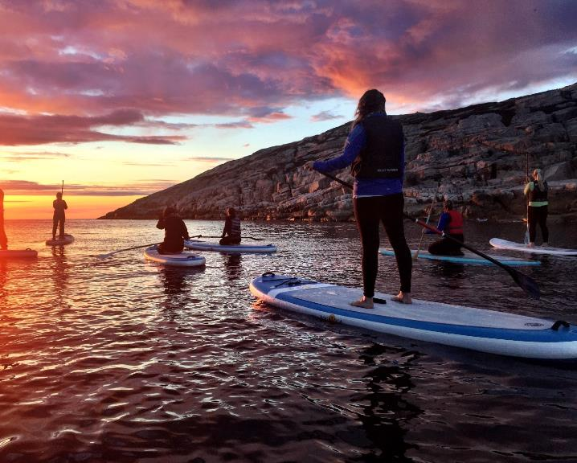
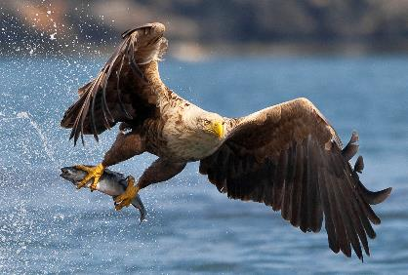
EAT THE FJORDS
DIVING INTO THE EXPERIENCE
MAJESTIC SEA EGLE SAFARI

Slide 11
WHITEWATER RAFTING AT VOSS

Slide 12
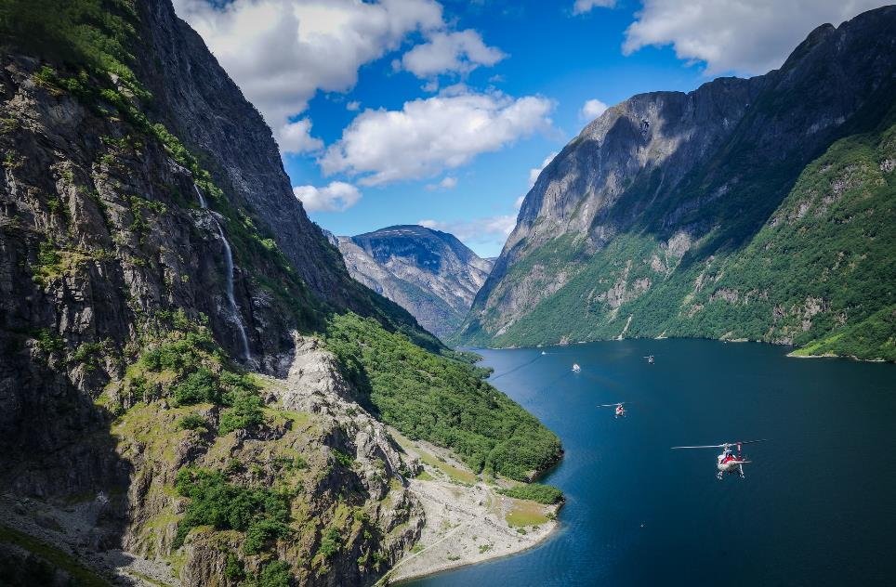
EXPERIENCE THE FJORDS BY HELICOPTER FROM BERGEN

Slide 13
Bergen – Proud host for UCI Road World Championship 2017

Slide 14
SEE YOU IN BERGEN! www.visitBergen.com/meetings

