Slide 1
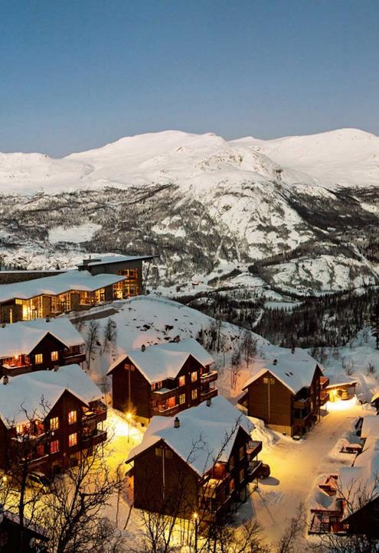

Norway Tourism
Qualitative Research
PREPARED BY
  Jonas Wagner, Ipsos UU
PREPARED FOR
  Innovation Norway
  March, 2017

Slide 2
Table of Contents
Introduction | 3
Key Insights & Recommendations | 8
Detailed Findings | 11
Fundamental Category Meaning | 12
How does Norway relate to these motivations? | 27
Where do our competitors sit? | 35
Additional Thoughts | 37
Opportunities for Growth | 39
Appendix | 41

Slide 3
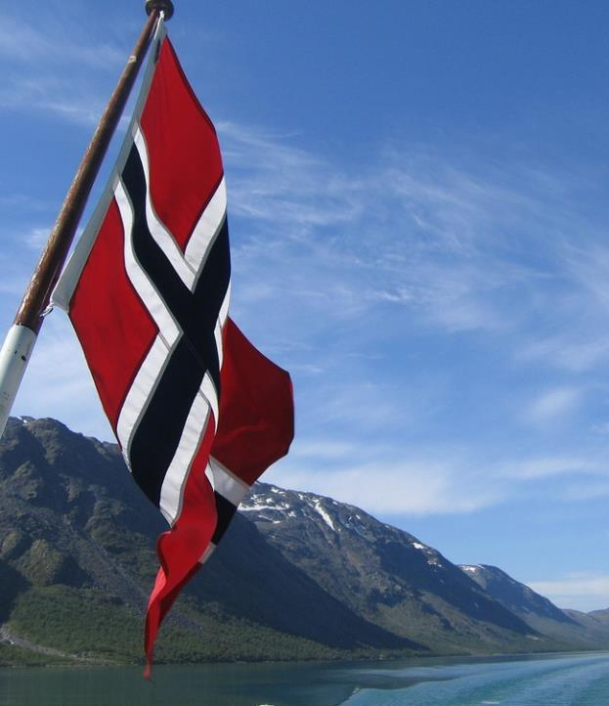
INTRODUCTION

Slide 4



Background
INTRODUCTION
Innovation Norway is looking to promote broader consideration of tourism among United States consumers to Norway. Innovation Norway sought to update the Censydiam study from 2011 for the German market and to conduct a similar study in France, China and the US.
  The last Censydiam study from 2011 focused on “nature based holidays.” The target groups for this new research are the same, but the client sought to take a deep dive into four important segments:
  The study explored all aspects of going on a holiday abroad. However, sun & beach holidays and pure shopping holidays were excluded from this study.
Outdoor activities (skiing, hiking, bicycling etc.)
Culture interest (local culture, history, art etc.)
Sustainability/Lohas (Lifestyle of health and sustainability – sustainable ecotourism, interest in organic and locally grown food)
Local food (Scandinavian food)

Slide 5

Objectives
INTRODUCTION
  The following objectives were central to, but not exhaustive of, the research that was conducted:
  To identify consumers’ motivations, emotions, drivers and barriers when choosing a destination abroad for different kind of holidays/different occasions.
  To identify consumers’ emotions, motivations, drivers & barriers towards taking a vacation to a Nordic country such as Norway
  To explore holiday behavior, rituals and occasions, seasons, travel groups in the local culture
  To explore the role of activities on holiday abroad (what/why)
  To explore the role of culture on holiday abroad including local culture, history, art etc. (what/why)
  To explore the role of food on holiday abroad (what/why)
  To explore the role of sustainability on holiday abroad (what/why)
  To understand potential & positioning of Norway as a destination including their perception of possible activities, local culture, sustainability and food in Norway.

Slide 6


Methodology
INTRODUCTION
specifications
Mix of gender
Mix of ages 25 – 65
Standard security: None to work in the travel/hotel industry (i.e., flight attendant, airline pilot, etc.)
No past 6 months’ participation
Standard recruiting specs including past participation
All must be working (none to be students or unemployed)
All must travel regularly abroad
All are interested in going to on a vacation to experience at least one of the following:
  outdoor activities, e.g. skiing, hiking or bicycling
  Sustainable ecotourism
  Organic and locally grown food
  Local culture, history, art etc.
  Local food/Nordic cuisine
All have to in the past three years have thought about going on holiday Norway.
Four 4-hour focus groups, recruiting 9 to seat 6 respondents in each group. Groups were conducted in Los Angeles, California, as follows:
FG #1 Women between 25-45 years old
FG #2 Men between 46-65 years old
FG #3 Men between 25-45 years old
FG #4 Women between 46-65 years old

Slide 7

Qualitative Caveat
QUALITATIVE METHODOLOGIES SEEK TO DEVELOP INSIGHT AND DIRECTION, RATHER THAN QUANTITATIVELY PROJECTABLE MEASURES.
  Due to the sample size, the recruitment methods used and the research objectives themselves, this study is exploratory in nature.
  These research findings are not intended to be projectable to a larger population.
  Respondent quotations included in this report are either verbatim, or encapsulations that have been edited for clarity/brevity, without altering the intended meaning.

Slide 8
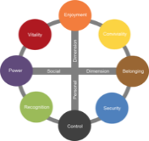
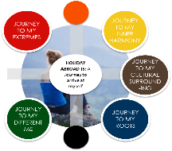
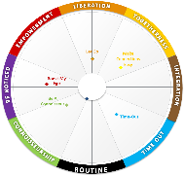
The main purpose of this report is to provide hypothesis that are to be tested quantitativly
1. We start with the Censydiam model and explore it qualitatively in focus groups.
2. The qualitative part then creates a hypothesis on how the Censydiam frame looks like within the holiday category.
3. At a later stage this hypothesis will be tested quantitativly in several markets to create one global segmentation model.
Example from the beer category
Please treat this report as qualitative indications on how the travel category looks like and wait for the final quantitative confirmation.

Slide 9

KEY INSIGHTS & RECOMMENDATIONS

Slide 10
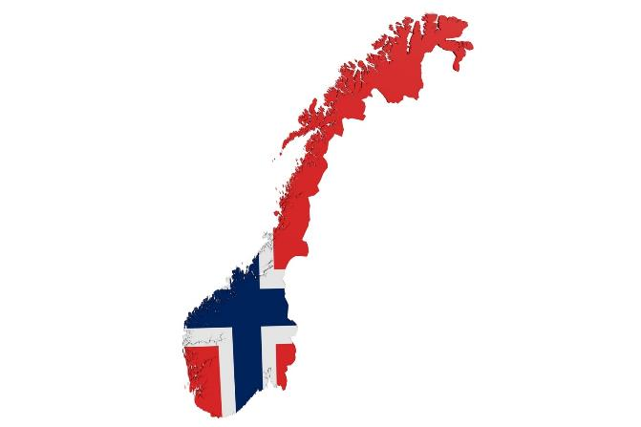
What is the key insight? What should be done?
EXECUTIVE SUMMARY
key insight:
There are two:
Lack of awareness and knowledge is driving lack of consideration.
Associations are primarily about things in nature (e.g., fjords and Northern Lights), which are appealing but do not seem to be sufficient.
recommended actions:
Build awareness. You have to be present to be considered.
Explore opportunities to benefit from capturing people’s imagination. Consider expanding a sense of the Norwegian experience — beyond places and things.
Leverage interest in the possibility of Norway being part of a Scandinavian vacation. Offer the Norwegian points of difference, in the context of the convenience and appeal of a robust Nordic vacation.

Slide 11
Key Opportunities
RECOMMENDATIONs
1
It is essential to first get travelers’ attention and awareness of Norway as an option. Consider this a kind of relaunch involving media and communication support.
Identify efficient points of leverage (e.g., social media)
2
Build on Norway’s positive associations (starting with the fjords and Northern lights).
  Travelers are not rejecting Norway. Negatives (primarily lack of familiarity and cold) seem very addressable.
3
Focus and develop perceptions that are truly Norwegian beyond nature and physical beauty.
  Consumers express interest in exploring new and different experiences – e.g., food, local interaction, and cultural immersion.
© 2017 Ipsos.

Slide 12
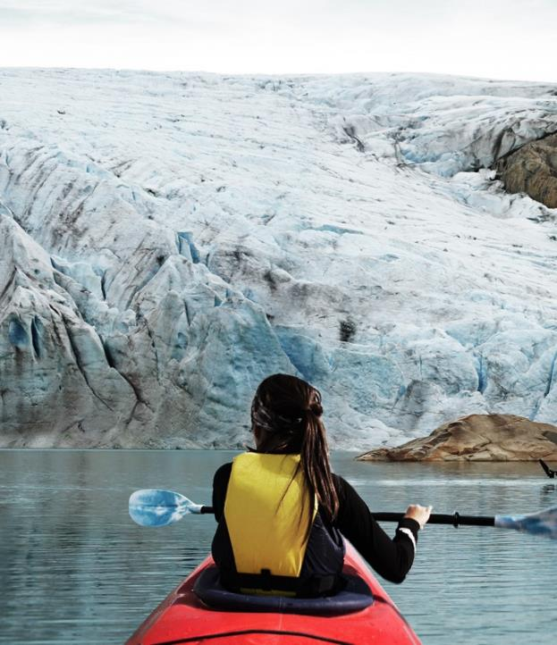
DETAILED FINDINGS

Slide 13

FUNDAMENTAL CATEGORY MEANING

Slide 14

What is the fundamental category meaning of vacations abroad?
Fundamental Category Meaning
Enriched Perspective - Immersing Yourself Into Something New And Different
key to understanding Enriched Perspective
Immersing yourself in something new and different while traveling is the result of a string of experiences.
Immersion can involve a variety of factors, incorporating people, places, things and activities.
However, it is more about the gestalt of experiences that it is about specific places and things.
Enriched perspective comes from leaving one’s everyday life temporarily and engaging in something entirely new.
It is relaxing and pleasurable to learn and experience
new things.

Slide 15
What is the fundamental category meaning? (cont’d)
Fundamental Category Meaning
Enriched Perspective - Immersing Yourself Into Something New And Different
Immersing yourself in something new and different is in part about breaking habits and opening your mind to help you grow as a person.
Immersion ends up feeling like an adventure — not necessarily risky, but filled with the joy of experiencing and engaging with new things.
Enriched perspectives come from the kind of experiences that would be fun to talk about and share — creating stories and lasting memories.
In the context of European — and certainly Scandinavian — countries, Iceland has done a good job of leveraging aspects of this concept.
There are indications that enriched perspectives are more likely to be non-city oriented.
Net: Enriched Perspective is multifaceted; it requires a collection of different types of perspectives and needs to be different from your daily reality. It changes you in some meaningful way.

Slide 16





Defining the Axes
FUNDAMENTAL CATEGORY MEANING
Enjoyment
Wanting the Best
Connecting
ENRICHED PERSPECTIVE
Organization

Slide 17
Defining the Motivational Landscape
FUNDAMENTAL CATEGORY MEANING
Enjoyment
Adventure
Inspiring
Opening Up
Wanting the Best
Connecting
“Brag-able” experience
ENRICHED PERSPECTIVE
Integration
Unconventional
Safety
Planning
Organization

Slide 18
Defining the Motivational Landscape
FUNDAMENTAL CATEGORY MEANING
Enjoyment
Intended and serendipitous
The pleasure of difference
Special moments
Ah-ha moments
Life changing
Adventure
Letting go
Embracing the moment
Inspiring
Opening Up
Not feeling like a tourist
Interacting with the locals
Wanting the Best
Connecting
“Brag-able” experience
ENRICHED PERSPECTIVE
Integration
Photographable
Having stories to tell
Unconventional
Safety
Physically safe
Comfortable enough to enjoy without worry
Creature comforts
Being in the know
Being/becoming an expert
Planning
Organization
Logistics
Managing time

Slide 19

Censydiam seeks to reveal the different layers within each motivation
FUNDAMENTAL CATEGORY MEANING
In the following slides each motivation will be explained through the following 4 layers:
Does it fit with my motivations?
What am I
looking for?
Functional Characteristics
More conscious,
rational
How should it
reflect upon me?
Social Identity
How will it help optimize life?
Emotional Benefits
Less conscious, more emotional, instinctive, symbolic
What should it
stand for?
Personality

Slide 20
This motivation is about the desire to have new and different experiences.
Orange – Adventure
functional characteristics
social identity
Different from home/everyday/daily life/personal experiences
Feeling intrigued
Could include being outside of your comfort zone
Discovery
People who
Have enough self-confidence to engage
Appreciate difference
Get energized by new experiences
“It [traveling] feels amazing. Something that you can’t convey in words.”
personality
emotional benefits
“I always look for a new and different type of vacation . . . something that is out of the ordinary.”
Fun
New and different
Exciting
Relaxing escape
Energizing
Transformational

Slide 21
This motivation is all about letting go and being open to new experiences.
Yellow – Opening Up
functional characteristics
social identity
Allowing yourself to experience something new
Seeking immersion
People who:
Enjoy interaction
Are extroverted
Are willing to engage
“It shapes your experience to see the culture, one that is new to you.”
personality
emotional benefits
Free
Easy going
Comfortable
Friendly
Feeling connected
Empathy
Energy
“Cultural exchange is priceless. It helps you feel differently, you become a new person.”

Slide 22
This motivation is all about engaging with people and culture.
Brown – Integration
functional characteristics
social identity
Social involvement -- vacation as much about people as it is about places.
For people who:
Are extroverted
Value the new and different
Enjoy the little moments, particularly when interacting with locals.
“I try not to bring my own preconceptions with me. I try to enjoy what is there.”
personality
emotional benefits
Intimacy
Embracing
Bonding
Warm
Feeling a part of something . .feeling connected in a personal way.
“It feels like you are in a different world. You are in their world.”

Slide 23
This motivation is all about feeling comfortable and protected.
Blue – Safety
functional characteristics
social identity
Physical safety
Situational comforts, the basics – temperature, bathroom, a comfortable home base from which to explore
For people who:
Need a certain level of physical comfort
Are concerned about safety
Want a local home
“I prefer a private bathroom and if I’m traveling with a girl you would want more privacy.”
personality
emotional benefits
Reliable
Secure
Worry free
Comfortable
Relaxed
Less anxious
Worry free – feeling safe from any physical harm
Calm
“I was more adventurous when I was younger and some of it has to do with what is going on in the world.”

Slide 24
This motivation is all about being organized and the comfort that comes from that.
Black – Planning
functional characteristics
social identity
Excursions and events
Organizing time so that you feel that you are getting the most out of the experience
For people who:
Like structure
Don’t want to miss anything
“I like to squeeze in as much as I can on my vacations.”
personality
emotional benefits
Well organized
Practical
Prudent
Neat
Safety, comfort in a guarantee
I use my time well
Making sure you get to do what you want to do
“We are picking places right now that may be too active for us to go on later in life.”

Slide 25
This motivation is all about reveling in being “in the know.”
Green – Unconventional
functional characteristics
social identity
Unique experiences
Finding and doing the best of whatever experiences are important to you
For people who:
View themselves as a connoisseur
Look for high quality in everything they do
View this kind of vacation as a collection – an experience collector
“I want one of a kind, a local feel. I think that is critical.”
personality
emotional benefits
“[I] Find the best local food – I ask the locals where they go. You can find some amazing places.”
Selective
Discerning
Skilled
Egotistical
Knowledgeable
Satisfaction from knowing that you found the best and – importantly, that you are good at finding it

Slide 26
This motivation is all about the joy of sharing.
Purple – Brag-able Experience
functional characteristics
social identity
Unique
Differentiated
Exciting experience
For people who:
Enjoy feeling respected
Are storytellers
Are comfortable being the center of attention and want to be the center
“I like to go to places where none of my friends have been.”
personality
emotional benefits
Exclusive
Superior
The best
Admiration
Feeling special
Pleasure of sharing and felling knowledgeable
Feeling respected
“If I am going to save up for a trip, I want to stay somewhere nice. I want to be on another level when I’m travelling.”

Slide 27
This motivation is all about that nearly spiritual feeling of being inspired.
Red – Inspiring
functional characteristics
social identity
Learning and growing
Emotionally and spiritually compelling moments
Rare experiences, a few times in your life
For people who:
Are open to new and different experiences
Are thoughtful
Are reflective
“[I travel for the] Life changing moments. It is about making memories.”
personality
emotional benefits
Invigorating
Disruptive
Inspiring
Fascinated
Uplifting
Self changing
Joy
Internal-external visceral experience
“I can still hear those drums. Just amazing. A moment that I will always remember.”

Slide 28
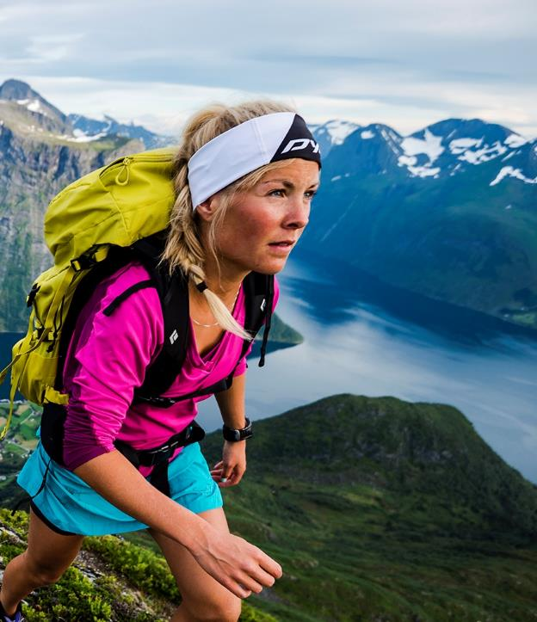
HOW DOES NORWAY RELATE TO THESE MOTIVATIONS?

Slide 29

The Norway Brand
HOW DOES NORWAY RELATE TO THESE MOTIVATIONS?
Norway has a positive, but clearly undeveloped, image among American tourists.
Associations with the country tend to be limited to elements of physical beauty and its Scandinavian location.
There seem to be limited barriers other than cold and cost.
The real barrier is lack of a clear sense of the experiences that are offered by Norway.
There are vague links to being a place for clean, outdoor activities.
Perceptions are more intellectual/rational
than emotional.

Slide 30
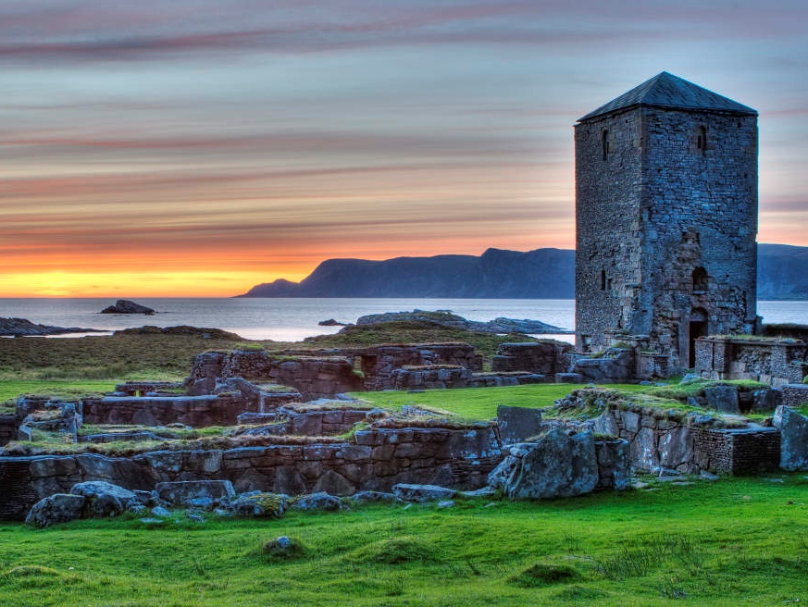
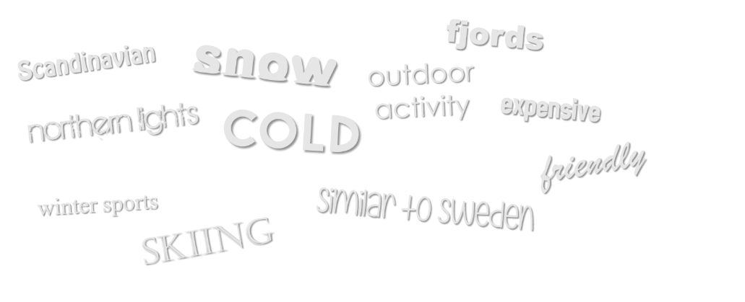
A Visual Snapshot of Norway
HOW DOES NORWAY RELATE TO THESE MOTIVATIONS?
28
© 2017 Ipsos.

Slide 31
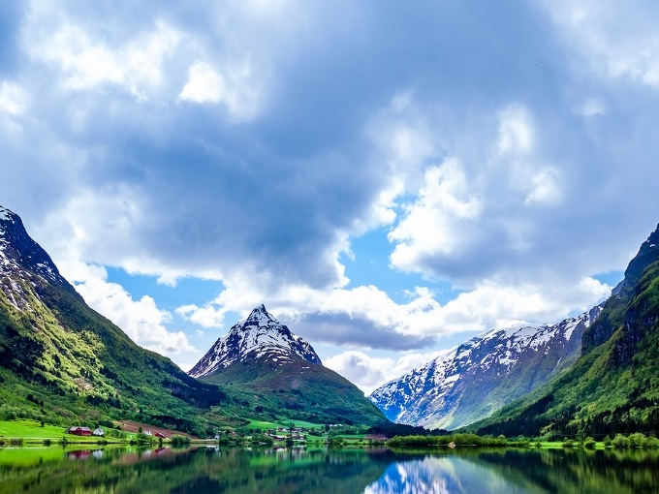
The Norway Brand (continued)
HOW DOES NORWAY RELATE TO THESE MOTIVATIONS?
For Americans, Norway is more about the lack of robust, clearly-defined positives than the presence of negatives.
key brand strengths
issues/weaknesses
Positive equity including fjords and northern lights
A very positive lifestyle, high quality of life, towns and villages – less urban
Idea of outdoor activities is assumed but not exciting (until they saw the pictures).
Safe
Cold
Expensive (not heard that frequently)
Not much related to Oslo, no expectations
Not much about food or culture – a blank slate
What Norway doesn’t have is what Iceland does have – a very positive vibe
  Not a lot of visual memory
Net: Norway represents a largely untapped opportunity for US tourism — one that can leverage clearly identified traveler motivations.
29
© 2017 Ipsos.

Slide 32

Norway Body
HOW DOES NORWAY RELATE TO THESE MOTIVATIONS?
social identity
People who are outdoorsy, active
Don’t always want a beach vacation
People who don’t want the same thing, they appreciate the new and different
Seeks out unique vacations, socially unconventional
For someone who is well traveled
functional characteristics
Physical beauty
Warm and friendly population
Less travelled, familiar
Less crowded. Less populated
Standard comforts, luxury features
Cold
Mixture of old and new
Coastal influence
© 2017 Ipsos.

Slide 33


Norway Soul
HOW DOES NORWAY RELATE TO THESE MOTIVATIONS?
emotional benefits
Safe
New and different
Adventurous
Potential for it to become a hip destination
Easy to engage with the people in the culture
personality
Female
Coziness, having to do with the cold and being a small country
Sophistication, they have the lifestyle figured out
Strong but beautiful
Natural
Intelligent
Friendly and nice but not exciting or crazy
Traveler
Small town, hospitable
© 2017 Ipsos.

Slide 34

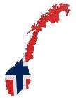

Where are we now?
HOW DOES NORWAY RELATE TO THESE MOTIVATIONS?
Reflecting both the motivational analysis and the opportunities provided by Norway (as understood in part from the Mood Boards), there is an opportunity to position Norway as addressing orange and red motivations.
Inspiring physical beauty and the opportunity for outdoor activities and engaging with friendly locals provide the opportunity for a compelling orange-red experience.
Enjoyment
Adventure
Inspiring
Opening Up
Norway has an under-developed brand equity.
Norway is often not on the motivational wheel but when it is, it is likely to be in blue and black, edging slightly into green (reflecting that Norway would be an unusual destination).
Wanting the Best
Connecting
“Brag-able” experience
ENRICHED PERSPECTIVE
Integration
Unconventional
Safety
Planning
© 2017 Ipsos.
Organization

Slide 35


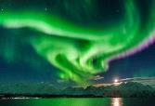
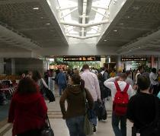

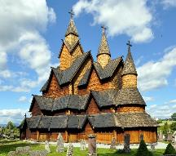
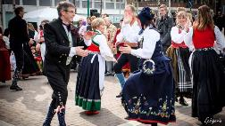

Moving Forward
HOW DOES NORWAY RELATE TO THESE MOTIVATIONS?
Norway Tourism needs to clearly define what it wishes to stand for
Promote events for local engagement (e.g., northern Lights Festival)
Limited awareness and knowledge (not quite a blank slate, but a sparsely populated one)
Explore how to most effectively and efficiency leverage media and messaging to build awareness and knowledge
  There are a number of challenges:
Reinforce — but do not focus on — ease of getting to and around the country. It is safe and comfortable.
Building a greater sense of the experience (as opposed to the place)
Consider secondary emphasis on Oslo nightlife and cultural experiences.
Effectively leveraging what is special about Norway — including, but moving beyond -- fjords and northern lights.

Slide 36
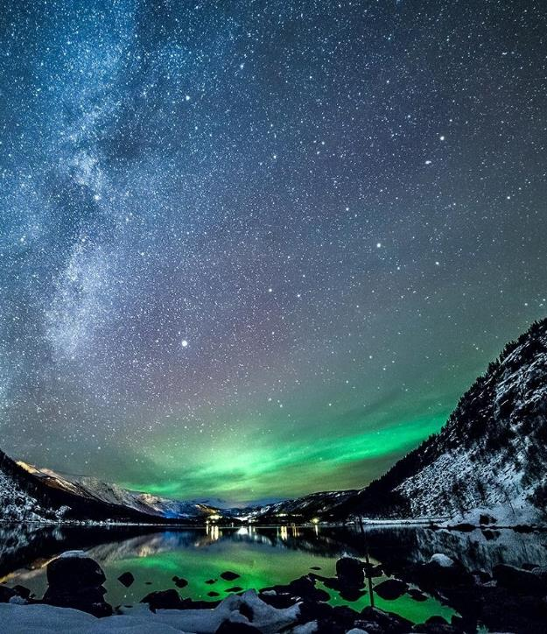
WHERE DO OUR COMPETITORS SIT?

Slide 37
Competitive Options
WHERE DO OUR COMPETITORS SIT?
Enjoyment
Iceland
orange
Adventure
Scotland & Ireland
yellow
Inspiring
Opening Up
Wanting the Best
Connecting
“Brag-able” experience
ENRICHED PERSPECTIVE
Integration
Unconventional
Safety
Note: Not in competition with city destinations like Paris, London, or Rome
Scandinavia in general:
primarily blue and black, some green
Planning
Organization

Slide 38
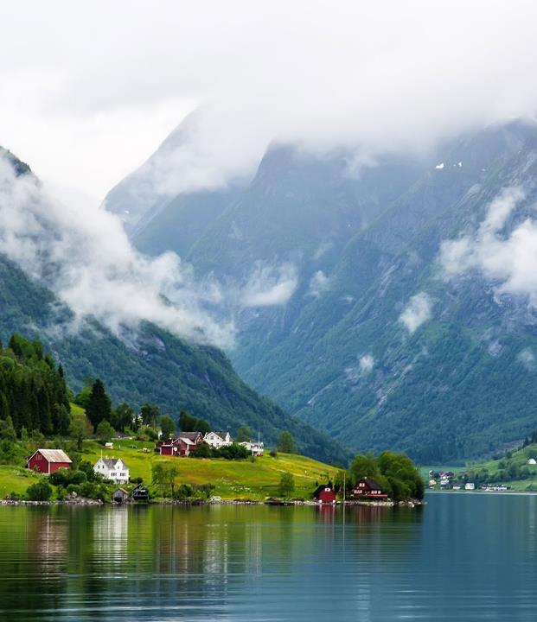
ADDITIONAL THOUGHTS

Slide 39
Additional Thoughts
WHERE DO OUR COMPETITORS SIT?
  Norway as Destination. We would cautiously hypothesize that at this juncture, consumers do not know enough about Norway to imagine it as a sole destination. Seeing it along with Sweden and Denmark seems natural for most.
  Sustainability. Sustainability – for most travelers we interviewed -- was a secondary (even tertiary) concern. Although many consumers (particularly in California) environmentally conscious, this does not seem to be a primary factor in vacation planning.
  Cuisine. Food is also secondary, not a driving reason to travel to Norway. However, greater familiarity may result in this being a meaningful part of the story.
  Social Media. A quick review of social media(outside the context of this research) suggests that Norwegian efforts to date have not meaningfully targeted American travelers. Explore more content that is created by American tourists and/or travel experts – most currently seems to be written by European tourists and is frequently not in English.
    Trolltunga, Fjords and Loften are often tagged for tourism but only show the natural beauty and few illustrate anything about what it feels like to be in Norway — not reinforcing the opportunity for an immersive experience.

Slide 40
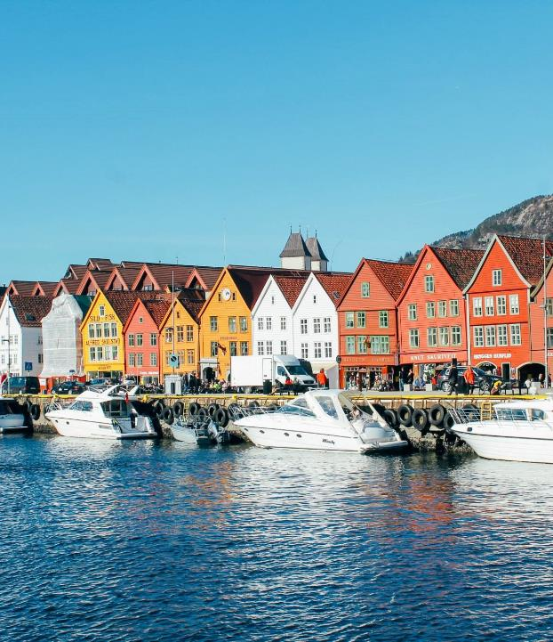
OPPORTUNITIES FOR GROWTH

Slide 41

STAY AWAY
Communications that focus primarily on physical beauty — a more static presentation
Subtle communication of Norwegian travel elements. At this juncture, marketing needs to be more aggressive.
DEVELOP
Communication of the Norwegian Experience.
Programs to support viral marketing of key Norway equities
Social media presence
Additional ways to efficiently support the sense of a changed perspective offered by Norway.
Create content that targets key interests – e.g., Top 10 things to do in Norway, Nightlife of Oslo, 10 things you didn’t know about Norway
KEEP
Communication of physical beauty (but not alone)
Suggestions of a friendly and welcoming attitude
Reference to easy travel arrangements -- before and while in country
Implications that Norway is a safe place to travel.
© 2017 Ipsos.

Slide 42
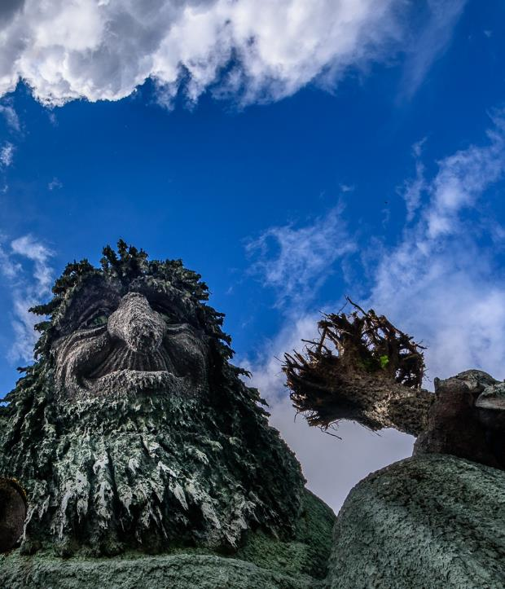
APPENDIX
Note: this section includes those respondent-made collages about the ideal vacation experience that are the most expressive.

Slide 43
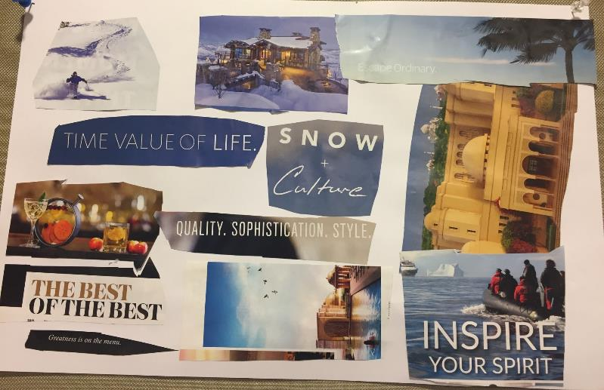
Group 1
Respondent collage

Slide 44
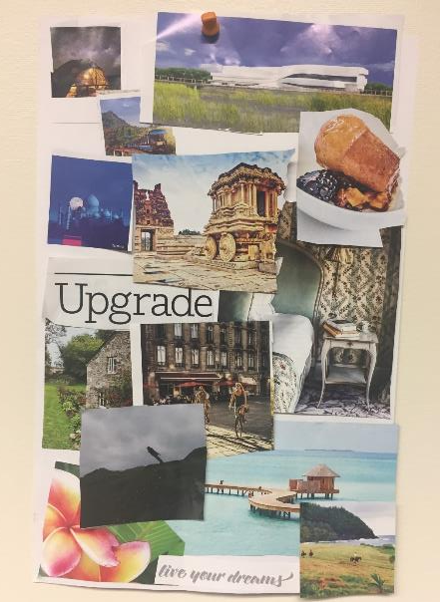
Group 2
Respondent collage

Slide 45
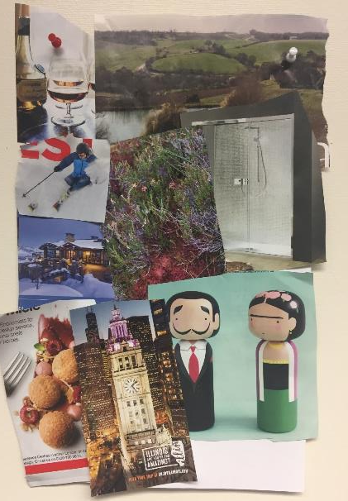
Group 4
Respondent collage

Slide 46
Appendix
DESCRIPTION | ATTACHMENT
Screener
Discussion Guides
Stimuli
The findings outlined in this document are qualitative in nature, and the work is exploratory as a result of the sample size and method by which the sample was drawn. Results should be regarded as directional and may not necessarily be projected to the larger population without further quantitative research. Comments written in italics with quotation marks are not necessarily direct quotations but are close paraphrases of respondent comments.
To open the documents double click on the link in “normal” mode.
Jonas Wagner
SENIOR VICE PRESIDENT
646.348.0789
Jonas.Wager@ipsos.com

Slide 47

ABOUT IPSOS
Ipsos ranks third in the global research industry. With a strong presence in 87 countries, Ipsos employs more than 16,000 people and has the ability to conduct research programs in more than 100 countries. Founded in France in 1975, Ipsos is controlled and managed by research professionals. They have built a solid Group around a multi-specialist positioning – Media and advertising research; Marketing research; Client and employee relationship management; Opinion & social research; Mobile, Online, Offline data collection and delivery.
Ipsos is listed on Eurolist - NYSE-Euronext. The company is part of the SBF 120 and the Mid-60 index and is eligible for the Deferred Settlement Service (SRD).
ISIN code FR0000073298, Reuters ISOS.PA, Bloomberg IPS:FP
www.ipsos.com
GAME CHANGERS
At Ipsos we are passionately curious about people, markets, brands and society. We deliver information and analysis that makes our complex world easier and faster to navigate and inspires our clients to make smarter decisions.
We believe that our work is important. Security, simplicity, speed and substance applies to everything we do.
Through specialisation, we offer our clients a unique depth of knowledge and expertise. Learning from different experiences gives us perspective and inspires us to boldly call things into question, to be creative.
By nurturing a culture of collaboration and curiosity, we attract the highest calibre of people who have the ability and desire to influence and shape the future.
“GAME CHANGERS” - our tagline - summarises our ambition.

Slide 48
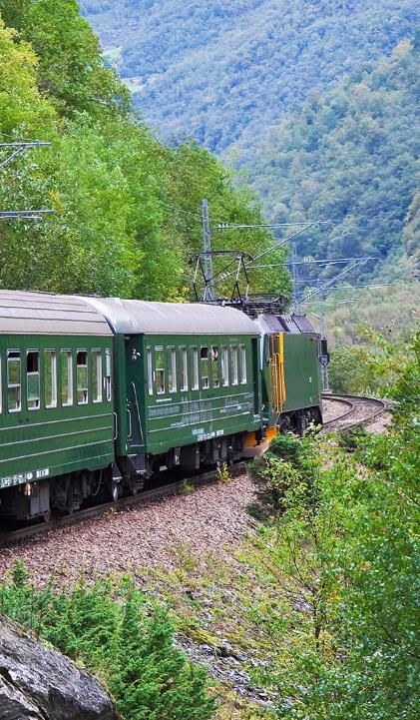
THANK YOU!

Slide 49
© 2017 Ipsos Insight LLC. All rights reserved. Contains Ipsos’ Confidential, Trade Secret and Proprietary Information.
The contents of this document constitute the sole and exclusive property of Ipsos Insight LLC (“Ipsos”) and/or the addressee and may not be used in any manner without the prior written consent of Ipsos. Ipsos retains all rights, title and interest in or to any of Ipsos' trademarks, technologies, norms, models, tools, proprietary methodologies and analyses, including, without limitation, algorithms, techniques, databases, computer programs and software, used, created or developed by Ipsos in connection with Ipsos' preparation of this document. No license under any copyright is hereby granted or implied.
The contents of this document are confidential, proprietary and are strictly for the review and consideration of the addressee and its officers, directors and employees. No other use is permitted, and subject to a separate written agreement between Ipsos and the addressee, the contents of this document (in whole or part) may not be disclosed to any third party, in any manner whatsoever, without the prior written consent of Ipsos.

