Slide 1
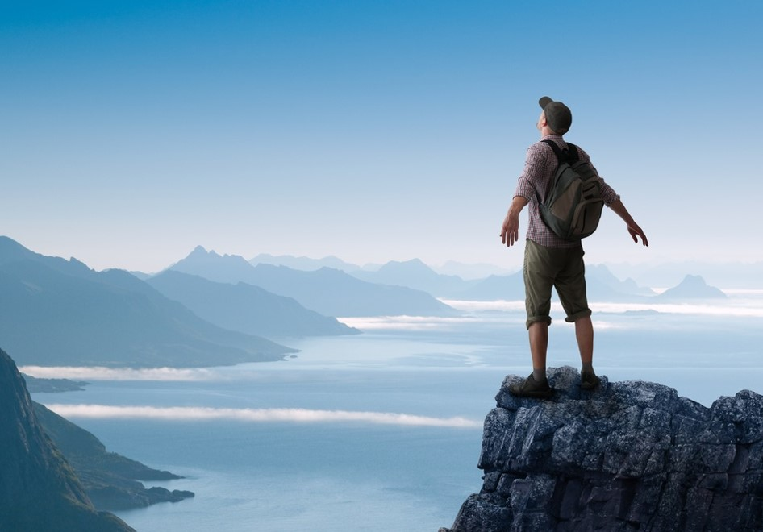
activating
The Norway brand
A Global report on holiday needs and segments
for Innovation Norway
Written by Kjetil Strømseth and Steven Naert 4th of October 2017

Slide 2
CONTENT
1) The philosophy behind
p 11
2) The ideal holiday and category behavior
p 23
3) Segments
p 34
4) Brand profile Norway
p 94
5)The competetive landscape
p 104
6) Conclusion and recommendations
p 108

Slide 3
Norway a true
The vision is «we give local ideas global opportunities»
Norway has unique advantages both in terms of natural resources and modern infrastructure that provides a great number of possibilities for tourists.
Innovation Norway manages not only one brand but the sum of all the brands that make up the destination Norway.
Some of these are iconic brands on a global scale.
The challenge is to secure a strong position for all of these so that the sum is stronger than individual parts, creating truly global power.
Global brand

Slide 4
The world is changing. The travel industry is changing. People change. How they interact with brands is changing. Their behavior in relation to vacation change.
You may have to adapt and make changes in the strategy to keep pace with the market.
Fundamental consumer insights in key markets is part of the basis for this.
Updated
insightful
proactive
Ipsos Report | August 2017 | Global report |

Slide 5
The purpose of the research:
TO IDENTIFY THE BEST MEANS OF STRENGTHENING THE FUTURE OF THE NORWEGIAN TRAVEL INDUSTRY
TO UNDERSTAND THE COMPETITIVE LANDSCAPE AND TARGET NEEDS TO PROMOTE INNOVATION AND COMMUNICATION
In order to do so, this research provides answers to the two questions:
- What is the ideal holiday?
- How are destinations (brands) positioned?

Slide 6
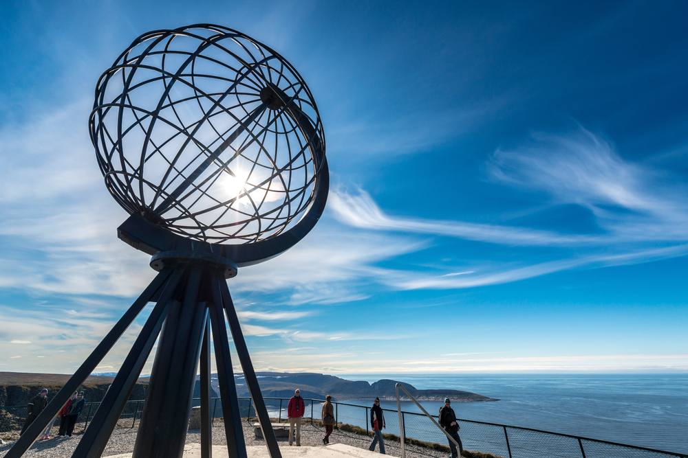
Behind the research
1
The philosophy
Point of view & approach

Slide 7
THE starting point:
understanding how brand building works
Brands that grow are brands that are chosen by…
MORE PEOPLE
At the Heart of Growing Brands is an understanding of how PEOPLE make CHOICES
And with increasing Brand Choices, it is more important than ever before to understand how the decision process works in people’s minds
MORE EASILY
MORE OFTEN
So how can Innovation Norway make it easier for more people to come to Norway more often?

Slide 8
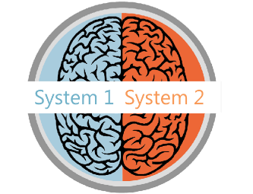
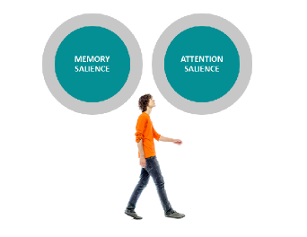
The key to brand building
is to think people first
How people make decisions
How people think about brands
How people are influenced
Decision-making is often more unconscious than conscious, using mental shortcuts to reduce effort.
Brands exist in peoples’ minds as a network: a unique memory structure of thoughts, feelings, experiences, images, stories, associations, colours, sounds, symbols and memories.
Memory salience refers to all the existing aspects of the brand’s mental network. Attention salience is about the cues and stimuli that capture our attention at any touchpoint.
So how do people make choices?

Slide 9
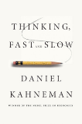
FORM
ARE SALIENT
ARE SALIENT
RELATIONSHIPS
They must come readily to mind in the moments that matter. They have strong brand networks or associative memory structures so they are easily retrieved in a fast-processing, automatic decision environment
They must fulfil the key motivational criteria for selection: meeting functional and emotional needs and creating connections
all the evidence points
ARE AVAILABLE
ARE AVAILABLE
To People being more
They must be accessible (e.g. pricing, distribution). The more easily people perceive that they can obtain one option rather than another similar option, the more likely it is to be selected
RANK FIRST
likely to choose
RANK FIRST
They must have the highest perceived value at the moment of choice, compared with alternatives
brands that…

Slide 10
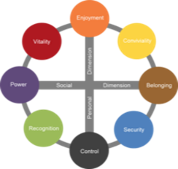
Building deep brand relationships with Censydiam
BE RELEVANT
Censydiam offers a validated approach to understand the different roles brands can play in the category.
Censydiam captures the needs & motivations that drive relevance in the category, while acknowledging that these needs & motivations can differ across various situations and occasions.
Brands can grow if they succeed in connecting themselves to more emotional & functional needs.
Associate your brand with relevant category roles
Censydiam
Motivational Framework

Slide 11
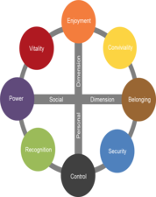
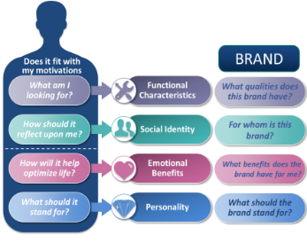
Censydiam in a nutshell
People first
All decisions are made with fundamental consumer needs at the heart
Universal
Comparison possible across markets
Customizable
Needs are tailored by context, category and markets.
theories about the unconscious mind and the mechanisms of release and repression
Each is deconstructed on key emotional and functional benefits, brands need deliver on in order to be relevant for consumers in various usage occasions/situations.
These benefits help build rich networks and allow consumers to easily identify the best solutions for their needs.
Validated
Over 30+ years experience across the globe & scientific thesis
The double mechanism for satisfaction: a striving for power & superiority and for belonging & community
Comparison
Allows comparison over time and markets

Slide 12
Censydiam seeks to uncover the different drivers
the brand needs to play on to be relevant
The ideal
holiday
Associations
to the
brand
First we uncover the ideal benefits sought in a specific holiday. Then we uncover what associations travelers have to different destinations
WHAT expectations are related to destinations?
DESTINATION CHARACTERISTICS
WHAT qualities does this destination have?
HOW should a holiday reflect upon me?
SOCIAL IDENTITY
WHO is the destination for?
WHY do people go on holiday?
EMOTIONAL BENEFITS
WHY do I go to
this destination?
WHAT should the destination stand for?
BRAND PERSONALITY
WHAT does this destination stand for?

Slide 13
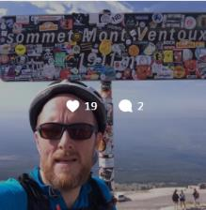
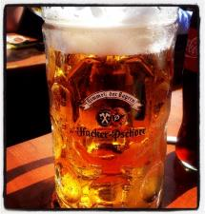
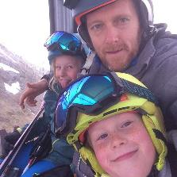
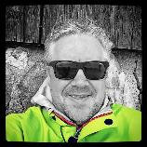
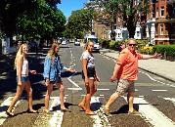
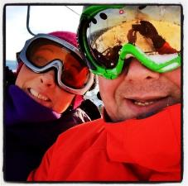
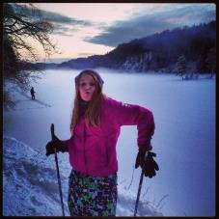
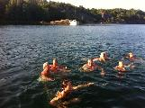
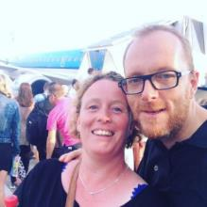
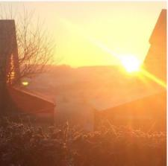
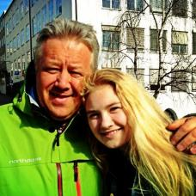
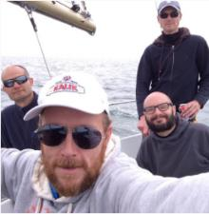
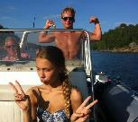
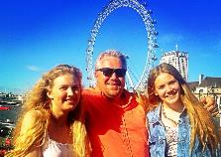
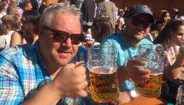
The same person, but different situations and different motivations
As consumers, we often have different needs depending on the situation. This also applies to holidays. A weekend getaway with a partner has to fulfil different needs than a skiing weekend with friends. This report is, therefore, based on different occasions – by occasion we mean different holidays. Each respondent has told us what the ideal holiday look like on two different holiday occasions.

Slide 14
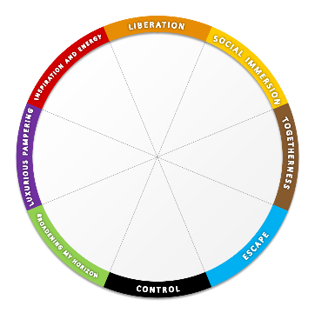
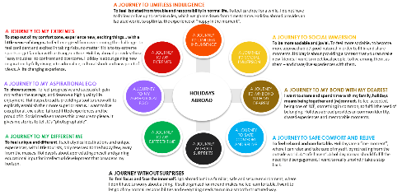
From Censydiam hypothesis to global category frame
We have conducted 12.000 interviews in 10 markets
Each respondent has profiled 2 holiday occasions – so we have 24.000 cases for analysis
1. We start with the Censydiam model and explore it qualitatively in focus groups.
2. The qualitative part then creates a hypothesis on how the Censydiam frame looks like within the holiday category.
3. At this stage this hypothesis have been tested quantitativly in several markets to create one global segmentation model.
Notes:
Validated every time

Slide 15
Questionnaire structure in the quantitative interview
The model shows the structure of the interview the individual respondent was through
Section 1: Demographics and Screener
Section 2: Category use
Section 3: Kategoribruk
Gender
Age
Income
Etc.
Have been abroad for holiday last 3 years.
How often do you go on holiday abroad?
Where did you go the last 5 holidays ?
Time of year, duration and type of holiday
What destinations do you know of?
How many times have you been on holiday to the following countries?
Section 4: Profiling of two holiday occasions
Section 5: Profiling of 2 holiday occasions
Section 6: Profiling of destinations
Type of holiday
Destination
Duration
Who were you with?
Spending
Accommodation
Transport
Information sources
Influencers
Activities
Consideration set (what destinations would you consider).
Emotional benefits
Functional benefits
Personality
Social identity
Please choose the statements that you think are appropriate for each destination.
We use the same statements as in section 5.

Slide 16
How does the needs come alive in the actual interview?
The needs are formulated as statements on 4 levels
Emotional benefits
Functional benefits
Personality
Social identity
Imagine that you would go on a similar holiday in the future (with the same people, the same destination, the same time, etc.), please tick the feelings and needs the ideal holiday experience should meet for this occasion
Which are the qualities and characteristics the holiday experience would ideally need to have for this occasion?
Please tick the words that fit the character of your IDEAL future holiday experience for this occasion
Which of the following types of people would you expect to look for the same holiday experience as you?
Helps me to enjoy life to the fullest
Makes me feel completely liberated
Makes me feel full of energy
Allows me to immerse myself in the local life
Helps me to meet new people
Allows me to share good times with others
Creates precious moments of togetherness
Allows me to intensify the relationship with my loved one(s)
Allows me to spoil my loved ones
Allows me to pamper myself
Helps me to escape from my hectic daily life
Restores my sense of harmony and balance
Allows me to keep everything under control
Helps me avoid too much surprises
Gives me a safe feeling
Allows me to broaden my horizon
Allows me to broaden my knowledge
Enriches my view on the world
Allows me to indulge myself with a bit of luxury
Makes me feel on top of the world
Makes me stand out from the crowd
Allows me to discover new and interesting places
Gives me rich experiences
Gives me new inspiration
Allows me to be physical active
Allows me to live close to nature
Has a variety of accommodation offers
Has a variety of different restaurant offers
Has activities for kids
Has beautiful nature
Has environmentally friendly offers
Has few language barriers
Has friendly people
Has good beaches
Has good local cuisine
Has good medical care
Has good opportunities to meet local people
Has good service
Has good shopping
Has guaranteed sunshine
Has interesting culture & art
Has interesting sights
Has lots of organized trips and excursions
Has places to go out partying
Has quiet environments
Has rich cultural heritage
Has romantic spots
Has unspoiled nature
Is easy to travel around
Is easy to travel to
Is not for just anybody, is exclusive
Is not ruined by tourism
Is not too warm
Is well organized
Offers a wide range of possible activities
Good value for money
Active
Playful
Fresh
Open-minded
Sociable
Outgoing
Caring
Friendly
Cozy
Harmonious
Peaceful
Relaxed
Practical
Structured
Predictable
Authentic
Unique
Cultivated
Extravagant
Superior
Classy
Explorative
Adventurous
Daring
People who want to have as much fun as possible in life
People that like to do things spontaneously, impulsively
People who likes to party
People who are always looking to connect with others
People who enjoy spending time with friends
People who have an active and busy social life
People for whom family comes first above all
People who enjoy taking care of others
People who have strong family values
People who want to escape from the demands of life and relax and unwind
People who needs time for themselves
People who want to revitalize themselves
People who make rational choices
People who prefer the familiar over the unknown
People who avoid risk
People who are interested to learn more
People who want to make a different choice
People that like to do things the unconventional way
People who want the best and are willing to pay for it
People who like to have the best things, value high quality
People who is sophisticated and classy
People who like to explore and have new experiences
People who like adventure
People who wants a life changing experience

Slide 17
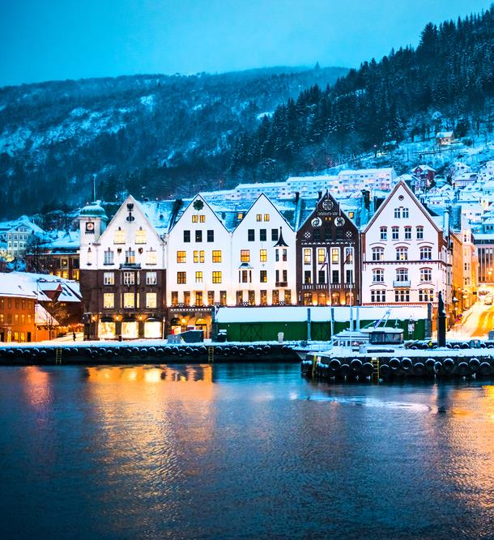
holiday
2
The ideal
Potential needs and drivers
Holidays abroad
experience
Main drivers globally
Global category needs

Slide 18
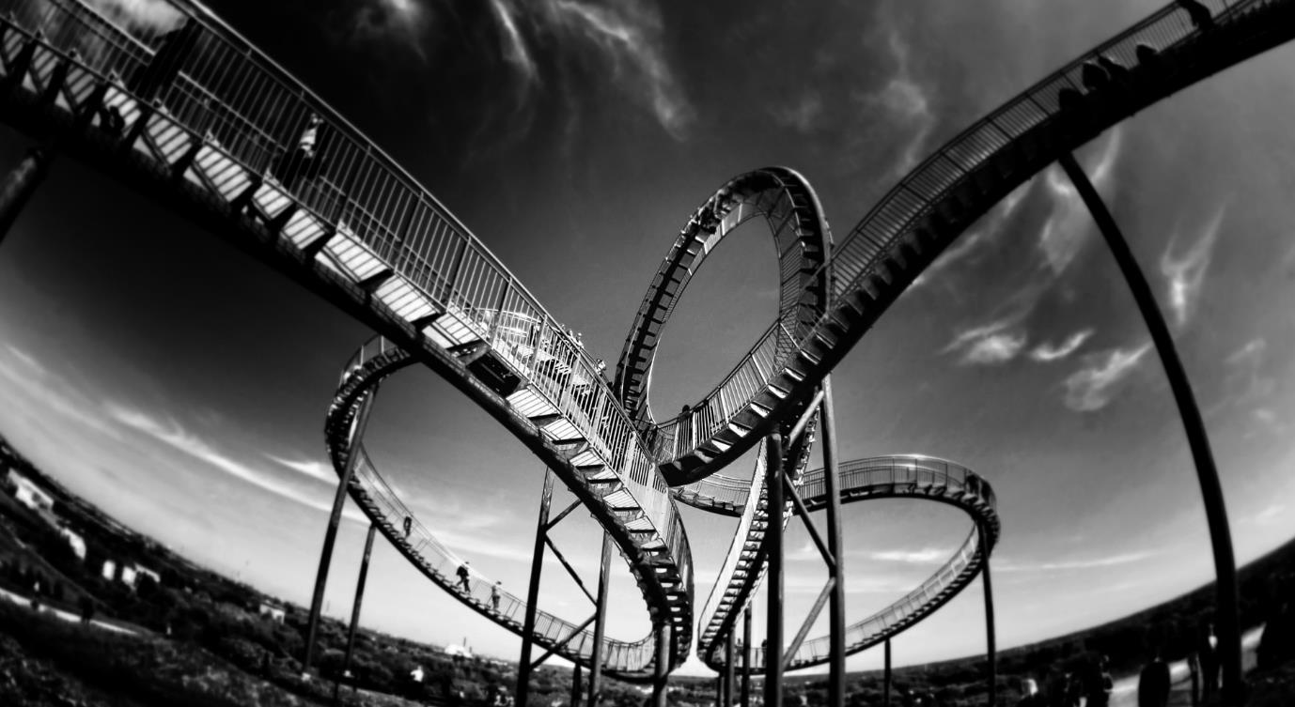
Emotional Benefits
WHY do people go on holiday?

Slide 19
Ideal destination characteristics
WHAT expectations are related to specific destination characteristics?

Slide 20
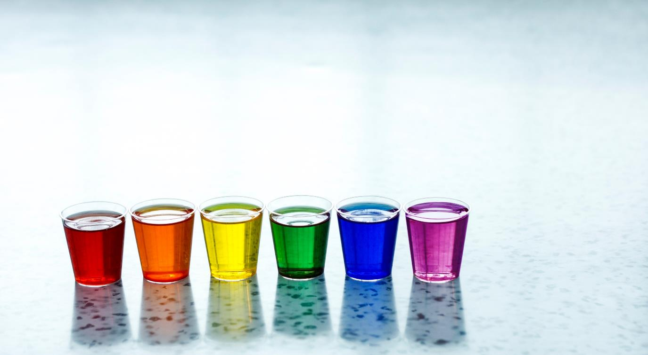
Ideal brand Personality
WHAT should the destination stand for?

Slide 21
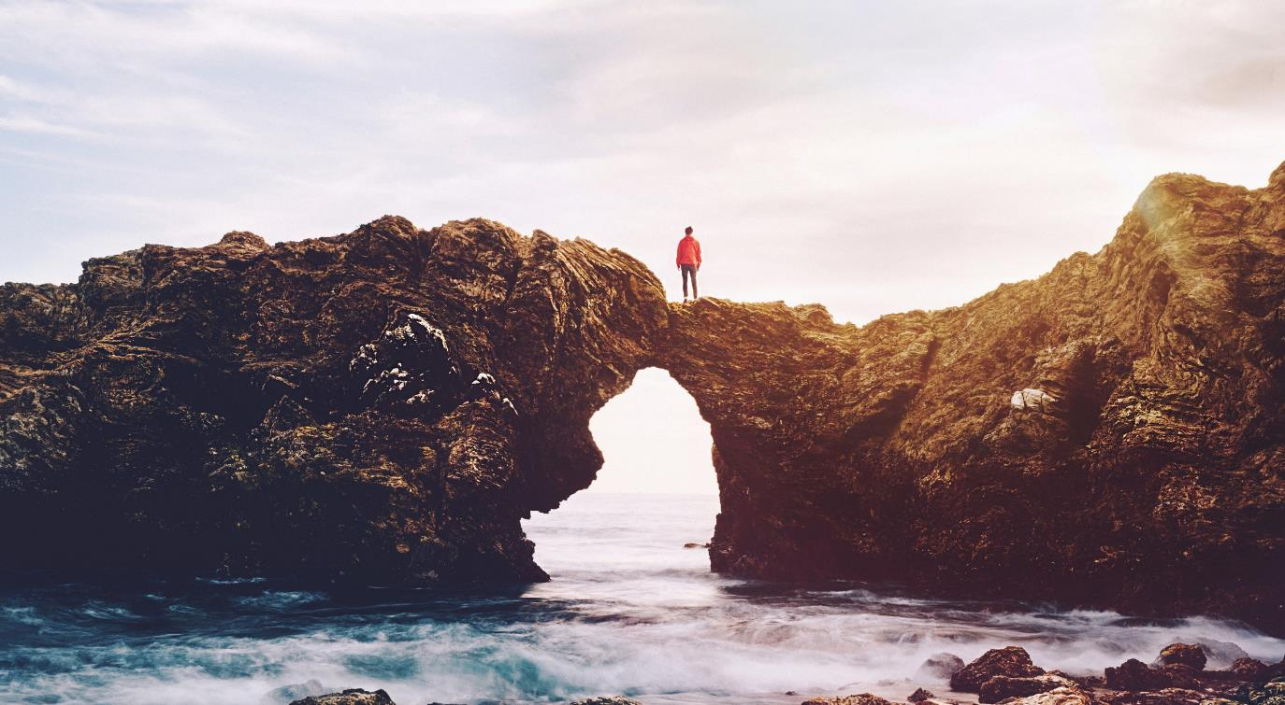
Ideal Social Identity
HOW should a holiday reflect upon me?

Slide 22
The way ahead for Norway to meet generic category expectations
These recommendations are on global level – there will be some market differences
Strengthen the emotional benefits
Develop destination features
Allows me to discover new and interesting places
Allows me to share good times with others
Has beautiful nature
Has friendly people
Has good local cuisine
Gives me rich experiences
Has interesting sights
Has rich cultural heritage
Good value for money
Is easy to travel to (except Sweden and Denmark)
Personality associations are slim
Weak social identity
Relaxed
Cozy
People who like to explore and have new experiences (weak in Sweden and Denmark)
People who want to escape from the demands of life and relax and unwind (strong in Denmark already)
Friendly
People who enjoy spending time with friends (strong in Denmark already)
People who are interested to learn more (strong in US and UK already)
Maintain
Strenghten

Slide 23
Category
behavior
With whom, how, when…

Slide 24
WHEN, WHO, HOW, where
Highlights on global category behavior
WHEN
WITH WHOM
HOW
TYPE OF ACCOMODATION
TRANSPORTATION
66 %
57 %
74 %
64 %
People travel all year long
- Off course some peaks in summertime
Spouse/partner
I/we organized the trip myself/ourselves and travelled independently
Lived at a hotel, I n most cases a medium standard hotel
Came by plane
TRANSPORTATION DURING THE HOLIDAY
%
%
%
%

Slide 25
Sources of information before and during travel
The digital channels are most important
20%
Advice from friends / family
30%
Uses the homepage of the destination as a source of information and inspiration before going on holiday
66%
Uses the internet in general as a source of information and inspiration before going on holiday. I.e. the large search engines are highly important to direct traffic to sites that present Norway as a tourist destination.
18%
Uses the homepage of carriers, including airlines etc.
27%
Uses the homepage for hotels/ other accommodations
21%
Uses the homepage for attractions and sights
17%
Guidebooks
15%
Uses booking sites such as Expedia and Lastminute
Base: all respondents, n=12.000

Slide 26
Most travels are decided upon between 1-6 months in advance
How long before your departure did you settle for this trip on this occasion?
Up to 1 month before departure
Up to 4-6 months before departure
Up to 3 months before departure
Up to 2 months before departure
Less than one week before departure
More than one year before departure
Up to 6-12 months before departure
1-3 weeks before departure
«Influence period 10%»
«Main decision period 69%»
«Last minute 18%»
Base: all respondents, n=12.000

Slide 27
Ever visited this country?
The Danes visit us most often and they keep coming back
 | Ever visited | Repeat visits | Repeat ratio
Global | 32 % | 18 % | 55 %
US | 25 % | 11 % | 43 %
UK | 20 % | 6 % | 30 %
Denmark | 81 % | 62 % | 76 %
Sweden | 79 % | 56 % | 71 %
China | 16 % | 6 % | 36 %
Spain | 10 % | 3 % | 28 %
Italy | 17 % | 4 % | 25 %
Netherlands | 25 % | 9 % | 35 %
France | 15 % | 3 % | 19 %
Germany | 26 % | 10 % | 39 %

Slide 28
A note on planning horizons
China, US and Italy has shorter planning horizon than the rest of the markets
How long before your departure did you settle for this trip on this occasion?
 |  | Market
 | Global | US | UK | Denmark | Sweden | China | Spain | Italy | Netherlands | France | Germany
Antall intervju | 21928 | 2158 | 2134 | 2192 | 2258 | 2280 | 2213 | 2168 | 2179 | 2205 | 2141
Less than 3 weeks before departure | 18 % | 24 % | 8 % | 12 % | 12 % | 30 % | 12 % | 44 % | 13 % | 13 % | 10 %
Up to 3 months before departure | 50 % | 49 % | 46 % | 50 % | 48 % | 64 % | 63 % | 44 % | 43 % | 50 % | 44 %
Up to 4-12 months before departure | 28 % | 23 % | 40 % | 35 % | 36 % | 5 % | 23 % | 6 % | 41 % | 33 % | 42 %
More than one year before departure | 1 % | 3 % | 3 % | 1 % | 3 % | 0 % | 1 % | 0 % | 1 % | 2 % | 2 %
Don’t know | 2 % | 1 % | 3 % | 2 % | 2 % | 0 % | 1 % | 7 % | 2 % | 1 % | 2 %
These differences will have impact on when to deploy marketing campaigns in the different markets

Slide 29
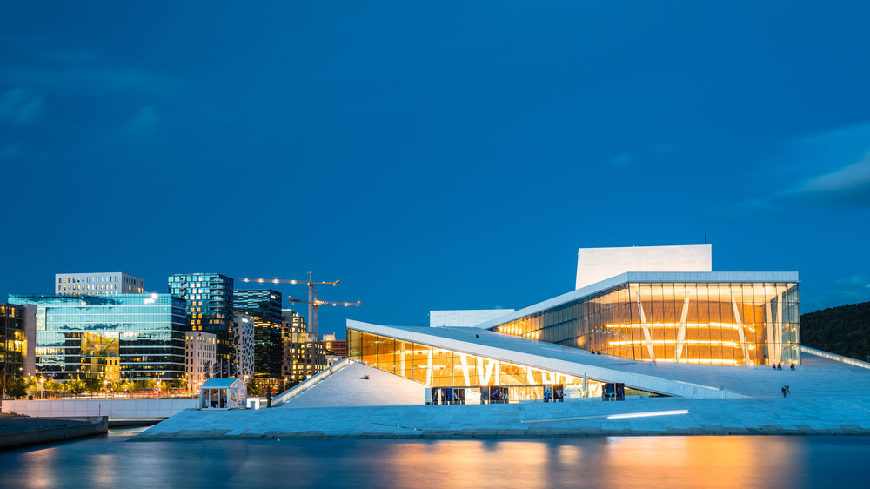
3
MOTIVATIONAL
SEGMENTS
Why
What
Who

Slide 30
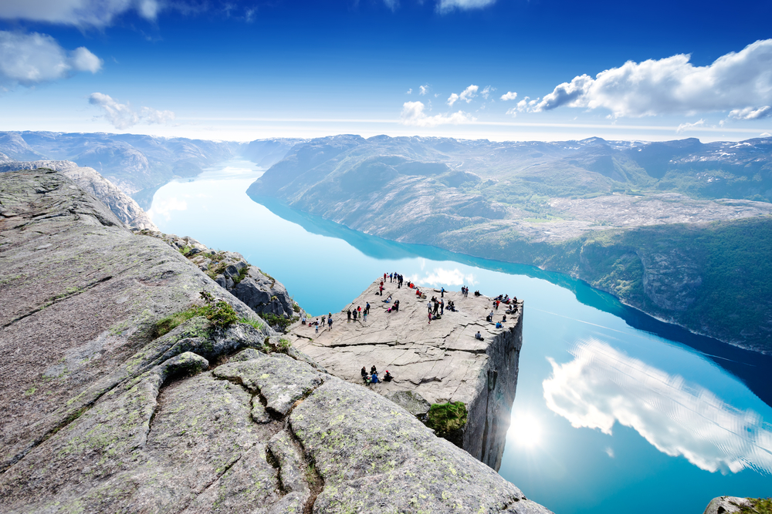
9 distinct segments
PLAYFUL LIBERATON
SOCIAL IMMERSION
SHARING & CARING
ESCAPE
CONTROL
BROADENING MY CULTURAL HORIZON
ADVENTURES IN the world of natural beauty
EXTRAVAGANT INDULGENCE
ENERGY

Slide 31
Segment overview and size
Playful Liberation is all about maximizing the pleasure I get out of a holiday and enjoying myself without worrying about the consequences
PLAYFUL LIBERATION
9%
Energy
9%
SOCIAL IMMERSION
11%
Energy is about adventure, being active, testing your boundaries and discovering new things. It taps into the need to be energized.
Social immersion is all about wanting to be harmoniously connected with other people.
HOLIDAYS ABROAD
EXTRAVAGANT INDULGENCE
12%
SHARING & CARING
10%
EXTRAVAGANT INDULGENCE
is about the need to indulge in some luxury. Find those romantic spots that really creates a feeling of extravagance.
Sharing & caring is all about spoiling my loved ones, intensify the relationship and Create precious moments of togetherness
The segment reflects the need to see something new, something spectacular like a natural phenomenon. It also connects with the need to immerse in unspoiled nature and travel to a destination not ruined by tourism.
ADVENTURES IN THE WORLD OF NATURAL BEAUTY
15%
ESCAPE
12%
Broadening my CULTURAL horizon
12%
Escape is about the experience of retreat, tranquility and quietness
CONTROL
10%
The segment reflects the need to learn about a foreign culture, stand out from the crowd. Something to talk about when coming home.
* Share of overnight stays: The segment volume is derived from the number of overnight stays on each occasion. The figures on the slide shows the share of overnight stays on all holidays
Control is about avoiding surprises and seek the familiar instead of the unknown.

Slide 32
Segment size* per market – large local differences
* Share of overnight stays: The segment volume is derived from the number of overnight stays on each occasion. The figures on the slide shows the share of overnight stays on all holidays.

Slide 33
Segments share of occasion – global
- all destinations
 | Total | PLAYFUL LIBERATON | SOCIAL IMMERSION | SHARING & CARING | ESCAPE | CONTROL | BROADENING MY CULTURAL HORIZON | ADVENTURES IN THE WORLD OF NATURAL BEAUTY | EXTRAVAGANT INDULGENCE | ENERGY
# interviews | 21928 | 2217 | 2202 | 2265 | 2574 | 2471 | 2828 | 2528 | 2780 | 2063
Visits to historic sites | 57 % | 57 % | 61 % | 42 % | 47 % | 56 % | 72 % | 66 % | 58 % | 53 %
Sun and beach holiday | 53 % | 58 % | 48 % | 57 % | 63 % | 52 % | 37 % | 49 % | 59 % | 57 %
Holiday to experience nature, scenery and wildlife | 46 % | 46 % | 45 % | 31 % | 51 % | 43 % | 43 % | 68 % | 45 % | 46 %
Sightseeing/round trip | 45 % | 49 % | 48 % | 34 % | 36 % | 46 % | 48 % | 52 % | 49 % | 45 %
Cultural experience (focus on art, theatre etc.) | 42 % | 49 % | 43 % | 26 % | 29 % | 43 % | 54 % | 45 % | 48 % | 40 %
City break (focusing on cultural, shopping, Club, restaurant visits etc.) | 42 % | 41 % | 44 % | 38 % | 34 % | 39 % | 50 % | 43 % | 42 % | 43 %
Visiting friends and relatives | 31 % | 28 % | 37 % | 42 % | 26 % | 31 % | 27 % | 33 % | 30 % | 32 %
Culinary trip | 19 % | 29 % | 19 % | 12 % | 13 % | 21 % | 14 % | 18 % | 28 % | 18 %
Party & fun | 16 % | 23 % | 15 % | 14 % | 11 % | 16 % | 10 % | 14 % | 21 % | 20 %
Sports/active holiday | 15 % | 17 % | 10 % | 10 % | 10 % | 19 % | 7 % | 20 % | 20 % | 27 %
Travel to cottage/holiday home (hired/own/borrowed cottage/holiday home) | 15 % | 13 % | 12 % | 18 % | 20 % | 15 % | 8 % | 13 % | 17 % | 16 %
Ski holiday | 11 % | 15 % | 6 % | 7 % | 7 % | 17 % | 3 % | 7 % | 18 % | 22 %
Event holiday (festivals, sports etc.) | 10 % | 14 % | 9 % | 6 % | 5 % | 13 % | 5 % | 9 % | 16 % | 11 %
Countryside holiday | 10 % | 12 % | 9 % | 8 % | 12 % | 10 % | 6 % | 11 % | 10 % | 9 %
Health travel | 9 % | 15 % | 6 % | 5 % | 7 % | 15 % | 3 % | 6 % | 17 % | 10 %
Other type of winter holiday with snow | 7 % | 10 % | 4 % | 3 % | 4 % | 12 % | 2 % | 6 % | 13 % | 10 %
Cruise | 7 % | 7 % | 7 % | 5 % | 6 % | 7 % | 8 % | 8 % | 9 % | 5 %

Slide 34
Major changes in the segmentation VS LAST TIME
NUMBER OF SEGMENTS This time we have 9 decent sized segments, last there were 8. I.e. we see a more fragmented picture of holiday needs this time.
NEW MEANING OF THE BLUE SEGMENT In the last segmentation the meaning of the blue segment was more in the direction of a «spa center» experience. This time it’s more about retreating to a quiet place. This could be a quite fisherman's cottage in Lofoten or a cabin in the mountains.
THE PREVIOUS RED AND GREEN SEGMENTS ARE DIVIDED In stead of a pure “Exploration” segment and one “Broadening my horizon” segment, we have a red segment (Energy), all about activity and a two green segments (Exploring the world of natural beauty) all about unspoiled nature, and “Broadening my cultural horizon” all about experiencing culture.

Slide 35
Playful Liberation is all about maximizing the pleasure I get out of a holiday and enjoying myself without worrying about the consequences. I go a little crazy, overindulge myself and lose all inhibitions. I am spontaneous, follow my instincts and live for the moment. The purpose of the holiday is abundance and enjoyment. It is impulsive and sometimes excessive or even manic.
PLAYFUL LIBERATION
PLAYFUL AND FRESH
PARTY AND FUN

Slide 36
PLAYFUL LIBERATION
Emotional benefits; What SHOULD THE HOLIDAY give me ?
The core meaning of going on holiday is to feel completely liberated. Give new energy and allow me to pamper myself.
Destination features and activities; What AM I looking for?
I want to go to a place with good beaches, good service and great shopping.
Of course I need relaxation, but I also need to experience nightlife, visit some amusement park and maybe some spa facilities.
PERSONALITY; WHAT SHOULD IT STAND FOR?
The destination needs to be playful and fresh.
Social identity; how should it reflect upon me?
The destination should be for people who likes to party. The kind that wants to have as much fun as possible in life. More or less people that like to do things spontaneously, impulsively.
Sometimes I need to let go. Enjoy life to the fullest and feel completely liberated. I need to refill my energy and pamper myself. Its all about me.
58%
ARE BELOW
40 YEARS
46%
54%
SHARE OF OVERNIGHT STAYS
9%

Slide 37
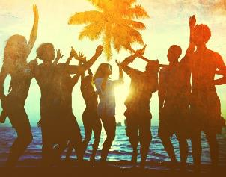
PLAYFUL LIBERATION
TYPICAL HOLIDAY OCCASIONS
Of course you will find the typical sun and beach vacation in this segment, but you will also find ski holidays and culinary trips. Although, most of the time it’s all about party and fun!
I TRAVEL TO FEEL GOOD
Of course I need relaxation, but I also need to experience nightlife, visit some amusement park and maybe some spa facilities.
THE ROLE OF BRANDS
The segment is important for brands/destinations which wish to position themselves as hedonistic and pleasure-seeking (or giving); and for brands which will position themselves in the space of sensuality, sexuality and sensory enjoyment.
HOLIDAY EXPERIENCE
These consumers are spontaneous travellers. They have their favourite spots, but they are driven by the “feel good factor” of what they see in social media or at booking sites. They want to travel to places that are approachable, fresh and playful.
SOURCES OF INSPIRATIONS
These consumers don’t spend a lot of time planning where to go. Most of them settle for the trip less than four weeks before they go. They act on what catches their eye in social media or on booking sites. It’s more like “in the spur of the moment”, a typical “last minute booker”. They would rather stay at home than travel without friends, and will often end up going somewhere if their friends tell them.

Slide 38
Playful LIBERATION - Active, relaxed and fresh
Core motivations
Emotional Benefits
Social Identity
Personality
Destination features
Notes:
Here it is crucial to insist on 4 things:
Stakeholders interview as per my comment on page 1: it is fundamental to understand what all users expect; it does not mean that collectively we will say yes to everything, but understanding potential challenges will help address this together
Formal deployment to make things official is also fundamental and too often forgotten: that have to be done together
We know things will not be perfect thus the importance of monitoring and adjusting the SOW if needed
It would be a big mistake to run fast in implementation: time we spend there is time we save later

Slide 39
Segment profile – playful liberation
Significantly over indexed in segment
Significantly under indexed in segment
TYPOLOGY
TRANSPORT AND ACOMMODATION
ACTIVITIES
TYPE OF HOLIDAY
TRANSPORT TO DESTINATION
ACTIVITIES
TRANSPORT ON DESTINATION
DURATION
ACCOMMODATION
TIME OF YEAR

Slide 40
Segment profile - playful liberation
Significantly over indexed in segment
Significantly under indexed in segment
PLANNING
DECISION MADE
INFLUENCERS
INFORMATION SOURCES
TRAVEL COMPANIONS
WHO DID YOU TRAVEL WITH
NUMBER OF TRAVEL COMPANIONS
TRAVEL FREQUENCY (NUMBER OF TIMES ABROAD)
HOW DID YOU TRAVEL

Slide 41
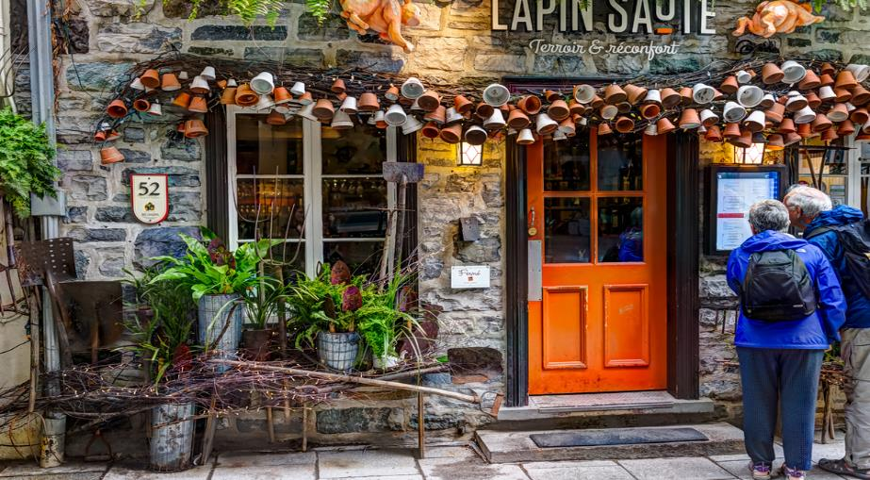
Social immersion is all about wanting to be harmoniously connected with other people. For me, meeting people is a joy. I love having good times with good friends and opening up and meeting new people.
SOCIAL IMMERSION
Sociable and open-minded
Meet local people, eat local cuisine

Slide 42
SOCIAL IMMERSION
Emotional benefits; What SHOULD THE HOLIDAY give me ?
The core meaning of going on holiday is to meet new people. I want to go a place where I can immerse myself in the local life and broaden my horizon. A place that enriches my view on the world. I want to discover new and interesting places.
Destination features and activities; What AM I looking for?
I want to destinations that has good opportunities to meet local people. It needs to be known for its friendly people. I want good local cuisine and interesting sights, interesting culture & art and a rich cultural heritage.
PERSONALITY; WHAT SHOULD IT STAND FOR?
The destination needs to be sociable, outgoing, open-minded, friendly and authentic.
Social identity; how should it reflect upon me?
The destination should be for people who are always looking to connect with others. People who enjoy an active and busy social life. People who enjoy spending time with friends. People who are interested to learn more. People who like to explore and have new experiences.
Sometimes I need to IMMERSE MYSELF INTO LOCAL LIFE, MEET NEW PEOPLE AND EAT LOCAL CUISINE
40%
ARE ABOVE
60 YEARS
48%
52%
SHARE OF OVERNIGHT STAYS
11%

Slide 43
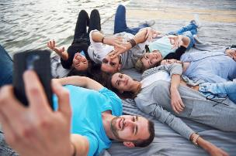
SOCIAL IMMERSION
TYPICAL HOLIDAY OCCASIONS
In this segment you will find trips to visit historical sites and at lot of sightseeing/ round trips. There are of course some sun & beach holidays here but moreover you will find holidays to experience scenery and wildlife as well as city breaks.
I TRAVEL TO MEET THE LOCALS
These consumers want to taste local food and drink. They want to visit cities and discover local culture and lifestyle. Local history and legends are also of interest. They want to experience local architecture and see visit historical buildings and sites. Museums is also on the list. The experience of national festivals and traditional celebrations are most appreciated.
THE ROLE OF BRANDS
The segment is important for brands which try to position themselves as enhancers of friendships, as social brands which help bring people together, and brands which are open, inclusive, and seeking to reflect shared pleasures. It is important for brands which seek to support collaboration with their customers.
HOLIDAY EXPERIENCE
These consumers are that organize their trip themselves and travels independently. They often travel with friends and seek a social experience in a new to them culture. They want to immerse themselves in local life and culture, connect with others and spend time with friends.
SOURCES OF INSPIRATIONS
Most of these consumers make their decision less than 4 months before their departure (63%). They act on what catches their eye in social media or on booking sites. Their spouse/partner heavily influences their choice.

Slide 44
SOCIAL IMMERSION - Active, relaxed and fresh
Core motivations
Emotional Benefits
Social Identity
Personality
Functional Characteristics
Notes:
Here it is crucial to insist on 4 things:
Stakeholders interview as per my comment on page 1: it is fundamental to understand what all users expect; it does not mean that collectively we will say yes to everything, but understanding potential challenges will help address this together
Formal deployment to make things official is also fundamental and too often forgotten: that have to be done together
We know things will not be perfect thus the importance of monitoring and adjusting the SOW if needed
It would be a big mistake to run fast in implementation: time we spend there is time we save later

Slide 45
Segment profile – SOCIAL IMMERSION
Significantly over indexed in segment
Significantly under indexed in segment
TYPOLOGY
TRANSPORT AND ACOMMODATION
ACTIVITIES
TYPE OF HOLIDAY
TRANSPORT TO DESTINATION
ACTIVITIES
TRANSPORT ON DESTINATION
DURATION
ACCOMMODATION
TIME OF YEAR

Slide 46
Segment profile - SOCIAL IMMERSION
Significantly over indexed in segment
Significantly under indexed in segment
PLANNING
DECISION MADE
INFLUENCERS
INFORMATION SOURCES
TRAVEL COMPANIONS
WHO DID YOU TRAVEL WITH
NUMBER OF TRAVEL COMPANIONS
TRAVEL FREQUENCY (NUMBER OF TIMES ABROAD)
HOW DID YOU TRAVEL

Slide 47
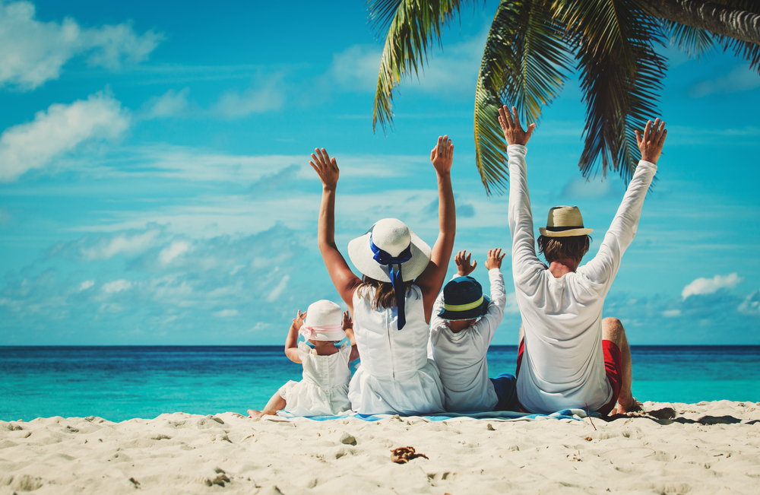
Sharing and caring is all about being surrounded by people who accept me as I am, as an equal and who make me feel welcome. Sharing and caring is about the need to be part of society or a group we really feel part of. Part of this is linked to following norms and traditions just because we are part of that culture or group. It is about togetherness, brotherhood, camaraderie, taking care of others, being taken care of by others, and doing and feeling good.
SHARING AND CARING
Sociable and friendly
Precious moments of togetherness

Slide 48
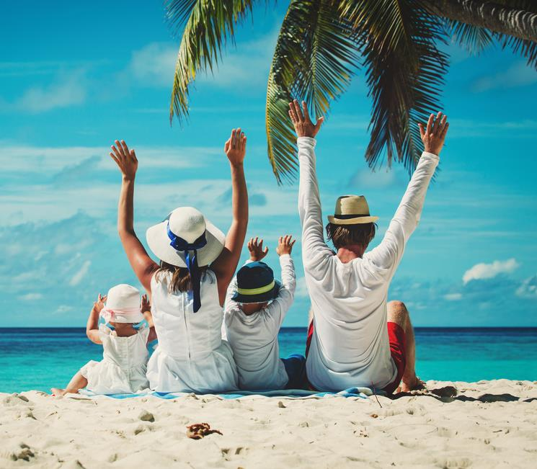
SHARING AND CARING
Emotional benefits; What SHOULD THE HOLIDAY give me ?
The core meaning of going on holiday is to spoil my loved ones. I want to intensify the relationship with my loved one(s) and create precious moments of togetherness. We want to share good times and escape from my hectic daily life.
Destination features and activities; What AM I looking for?
It has to be a destination that is easy to travel to. I want few language barriers and good value for money. My family needs guaranteed sunshine. It should have friendly people, good beaches, and a variety of different restaurant offers. We like to enjoy good local cuisine. We also like to travel around so it has to be easy to travel around.
PERSONALITY; WHAT SHOULD IT STAND FOR?
The destination needs to be sociable, friendly, relaxed, cozy, harmonious and peaceful.
Social identity; how should it reflect upon me?
The destination should be for people for whom family comes first above all. This is people who have strong family values. People who enjoy spending time with and enjoy taking care of others. People who want to escape from the demands of life and relax and unwind
Sometimes I need to SPOIL MY LOVED ONES AND CREATE PRECIOUS MOMENTS OF TOGETHERNESS. My family comes first above all.
74%
ARE ABOVE
40 YEARS
50%
50%
SHARE OF OVERNIGHT STAYS
10%

Slide 49
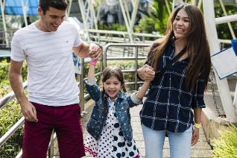
SHARING AND CARING
TYPICAL HOLIDAY OCCASIONS
You will find the typical sun and beach vacation in this segment also, but you will find more holidays to visit friends and family and travels to cottage/holiday homes here than in other segments. For these consumer it’s all about family.
I TRAVEL TO FEEL INCLUDED
These consumers choose destinations that enables them to spend time with their loved ones. They want to travel to places that are sociable, friendly and relaxed. They want to create those precious moments of togetherness.
THE ROLE OF BRANDS
Brands that want to tap into the needs in this segment should focus on support, empathy, care giving and true, deep friendships. They should position themselves as familiar and appealing to a broader audience and tap into those feelings that people get when they feel warm, included and accepted by the people or tribe they are with.
HOLIDAY EXPERIENCE
Relaxation is on top of the list. Activities like sunbathing and swimming, and getting pampered is also appreciated by this segment. They like to taste local food and drinks and observe the beauty of nature as long as the activities are slow, warm and friendly. No pushing boundaries please!
SOURCES OF INSPIRATIONS
Of course they use the internet, but more than in other segments they act on advice from friends/family. Parents and other relatives heavily influences their choice. They travel with children and the oldest children are a part of the decision process.

Slide 50
SHARING AND CARING
Core motivations
Emotional Benefits
Social Identity
Personality
Functional Characteristics
Notes:
Here it is crucial to insist on 4 things:
Stakeholders interview as per my comment on page 1: it is fundamental to understand what all users expect; it does not mean that collectively we will say yes to everything, but understanding potential challenges will help address this together
Formal deployment to make things official is also fundamental and too often forgotten: that have to be done together
We know things will not be perfect thus the importance of monitoring and adjusting the SOW if needed
It would be a big mistake to run fast in implementation: time we spend there is time we save later

Slide 51
Segment profile – SHARING AND CARING
Significantly over indexed in segment
Significantly under indexed in segment
TYPOLOGY
TRANSPORT AND ACOMMODATION
ACTIVITIES
TYPE OF HOLIDAY
TRANSPORT TO DESTINATION
ACTIVITIES
TRANSPORT ON DESTINATION
DURATION
ACCOMMODATION
TIME OF YEAR

Slide 52
Segment profile - SHARING AND CARING
Significantly over indexed in segment
Significantly under indexed in segment
PLANNING
DECISION MADE
INFLUENCERS
INFORMATION SOURCES
TRAVEL COMPANIONS
WHO DID YOU TRAVEL WITH
NUMBER OF TRAVEL COMPANIONS
TRAVEL FREQUENCY (NUMBER OF TIMES ABROAD)
HOW DID YOU TRAVEL

Slide 53
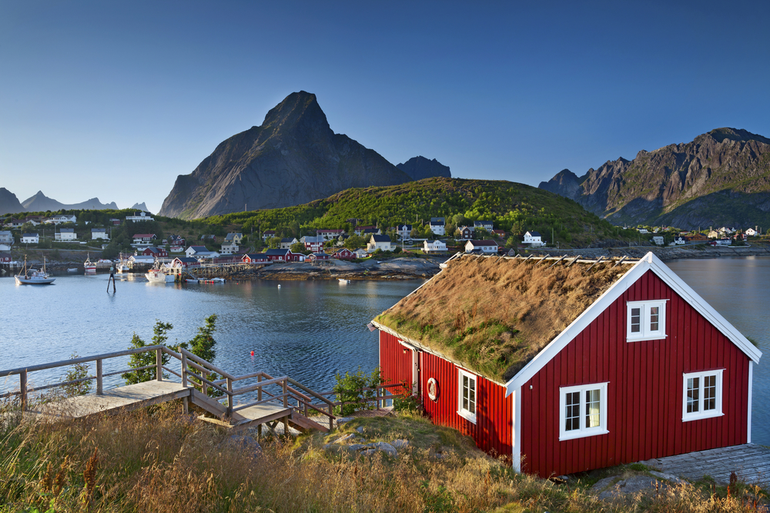
Escape is about the experience of retreat, tranquility and quietness. These are the holidays one feels the need to retreat and recharge. One is looking for an experience that sooths, comforts and takes away the stresses and strains of hectic daily life. These are the holidays one withdraws to a physical or mental space that is worry free - an almost childlike state of feeling safe and cared for.
ESCAPE
PEACEFUL AND HARMONIOUS
RESTORE MY SENSE OF HARMONY AND BALANCE

Slide 54
ESCAPE
Emotional benefits; What SHOULD THE HOLIDAY give me ?
The core meaning of going on holiday is to restore my sense of harmony and balance. I need to escape from my hectic daily life, and pamper myself. I want to feel completely liberated, enjoy life to the fullest and recharge.
Destination features and activities; What AM I looking for?
I want to go to a place that has quiet environments, and allows me to live close to nature. It should not be ruined by tourism. I need good beaches and guaranteed sunshine. I would also like beautiful unspoiled nature.
PERSONALITY; WHAT SHOULD IT STAND FOR?
The destination needs to be peaceful, harmonious, relaxed and cozy.
Social identity; how should it reflect upon me?
The destination should be for people who needs time for themselves. People who want to revitalize themselves, and escape from the demands of life and relax and unwind.
Sometimes I need to restore my sense of harmony and balance. Escape from the demands of life, relax and unwind.
40%
ARE BETWEEN
40-59 YEARS
53%
47%
SHARE OF OVERNIGHT STAYS
12%

Slide 55
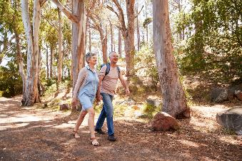
ESCAPE
TYPICAL HOLIDAY OCCASIONS
Of course you will find the typical sun and beach vacation in this segment, but you will find more travels to cottage/holiday home and countryside holidays than in other segments.
I TRAVEL TO A QUIET PLACE
These consumers choose destinations that makes them restore their sense of harmony. They travel by car to a greater extent than other segments and they are also more prune to stay at a cabin, holiday home or flat than in other segments. They normally stay for 7-14 days.
THE ROLE OF BRANDS
This segment is important when brands want to profile themselves as supporting people in relieving stress and tension. These are the brands and companies that focus on protection and prevention against danger and harm in everyday life. These brands function as a safety net around us, our families and loved ones.
HOLIDAY EXPERIENCE
Relaxation is on top of the list more than in other segments. The same goes for observing the beauty of nature. Activities like sunbathing and swimming, and getting pampered is also appreciated by this segment. They like to taste visit the countryside and do hiking. As long as the activities are in quiet environments close to nature we are in line with segment needs.
SOURCES OF INSPIRATIONS
Many of these consumers decide on the trip well ahead of departure. 34% of them settle for the trip four months or more before they go. They are not over indexing on any information source, and the internet in general is the largest point of inspiration.

Slide 56
ESCAPE
Core motivations
Emotional Benefits
Social Identity
Personality
Functional Characteristics
Notes:
Here it is crucial to insist on 4 things:
Stakeholders interview as per my comment on page 1: it is fundamental to understand what all users expect; it does not mean that collectively we will say yes to everything, but understanding potential challenges will help address this together
Formal deployment to make things official is also fundamental and too often forgotten: that have to be done together
We know things will not be perfect thus the importance of monitoring and adjusting the SOW if needed
It would be a big mistake to run fast in implementation: time we spend there is time we save later

Slide 57
Segment profile – ESCAPE
Significantly over indexed in segment
Significantly under indexed in segment
TYPOLOGY
TRANSPORT AND ACOMMODATION
ACTIVITIES
TYPE OF HOLIDAY
TRANSPORT TO DESTINATION
ACTIVITIES
TRANSPORT ON DESTINATION
DURATION
ACCOMMODATION
TIME OF YEAR

Slide 58
Segment profile - ESCAPE
Significantly over indexed in segment
Significantly under indexed in segment
PLANNING
DECISION MADE
INFLUENCERS
INFORMATION SOURCES
TRAVEL COMPANIONS
WHO DID YOU TRAVEL WITH
NUMBER OF TRAVEL COMPANIONS
TRAVEL FREQUENCY (NUMBER OF TIMES ABROAD)
HOW DID YOU TRAVEL

Slide 59
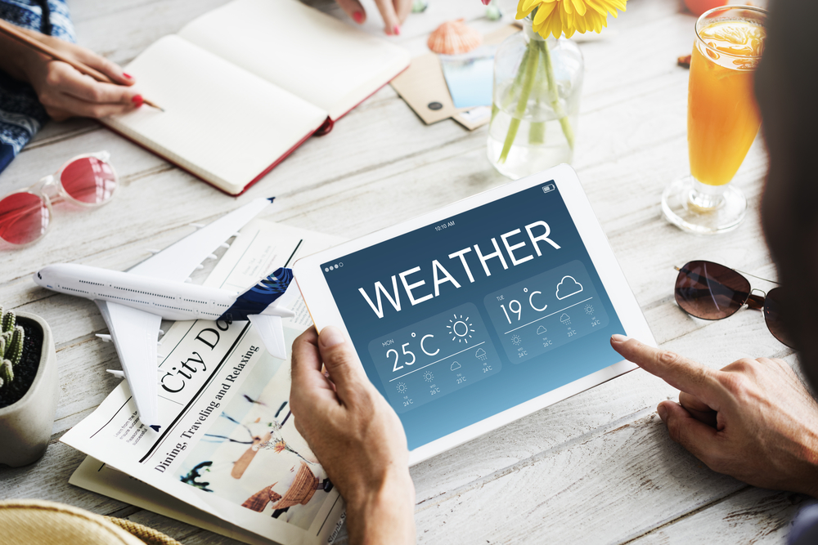
Control is about avoiding surprises and seek the familiar instead of the unknown. There are holidays when I like to be completely in control, to keep things in order, keeping it practical and predictable feels quite comfortable and safe. This gives me a sense of stability and structure.
CONTROL
PRACTICAL AND PREDICTABLE
AVOID SURPRISES

Slide 60
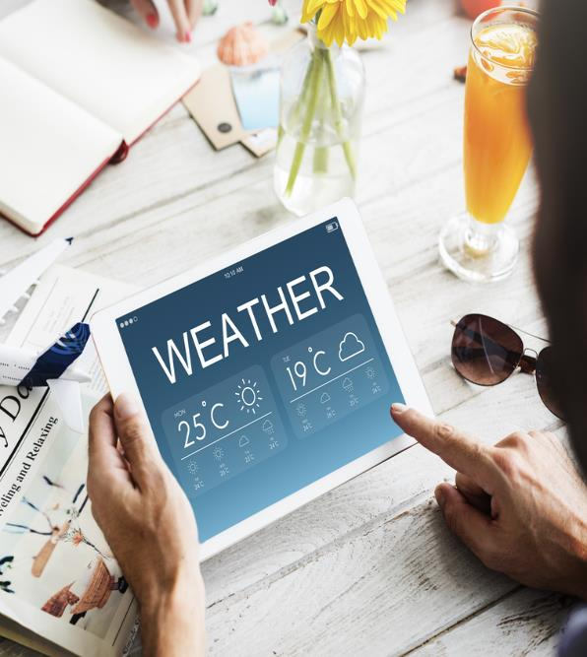
CONTROL
Emotional benefits; What SHOULD THE HOLIDAY give me ?
The core meaning of going on holiday is to keep everything under control. I want to avoid too much surprises. I want a holiday that gives me a safe feeling.
Destination features and activities; What AM I looking for?
I want to go to a place that is well organized and not too warm. Good service is important to me. It has to be easy to travel to.
PERSONALITY; WHAT SHOULD IT STAND FOR?
The destination needs to be practical, predictable and structured.
Social identity; how should it reflect upon me?
The destination should be for people who make rational choices. People who prefer the familiar over the unknown. Basically people who avoid risk.
I LIKE TO KEEP EVERYTHING UNDER CONTROL AND AVOID SURPRISES. I HAS TO BE WELL ORGANIZED, PRACTICAL AND PREDICTABLE.
41%
ARE BETWEEN
30-49 YEARS
39%
61%
SHARE OF OVERNIGHT STAYS
10%

Slide 61
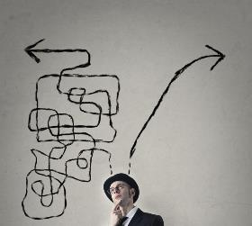
CONTROL
TYPICAL HOLIDAY OCCASIONS
Although the typical sun and beach vacation and visits to historic sites dominates in this segment, you will also find ski holidays and sports/active holidays to a greater extent than in other segments. The same goes for health travel, event holiday and other type of winter holiday with snow. This is mainly driven by the Danish and the Swedish market.
I TRAVEL TO AVOID SURPRISES
These consumers choose destinations that is well organized. They want to travel to places that are practical, predictable and structured. They want to have a informal, fun and relaxed holiday at the same time.
I want to avoid too much surprises!
THE ROLE OF BRANDS
Control plays an important role for brands if they are aimed at structuring people’s lives or when the focus is on risk management, simplifying life, avoiding surprises. Brands that want to position themselves on Control should offer rational arguments and focus on functionality, maturity, health, purity, hygiene, and less in impulsiveness and fun.
HOLIDAY EXPERIENCE
Relaxation is on top of the list. This segment is under indexing on many activities, so a less active segment. They would like to visit cities and have restaurant meals.
SOURCES OF INSPIRATIONS
These consumers travel with children so they are highly influenced by b their spouse and their children. Many travel in a group with an organized tour (32%). They do not use that many information sources because the go to a place they know.

Slide 62
CONTROL
Core motivations
Emotional Benefits
Social Identity
Personality
Functional Characteristics
Notes:
Here it is crucial to insist on 4 things:
Stakeholders interview as per my comment on page 1: it is fundamental to understand what all users expect; it does not mean that collectively we will say yes to everything, but understanding potential challenges will help address this together
Formal deployment to make things official is also fundamental and too often forgotten: that have to be done together
We know things will not be perfect thus the importance of monitoring and adjusting the SOW if needed
It would be a big mistake to run fast in implementation: time we spend there is time we save later

Slide 63
Segment profile – CONTROL
Significantly over indexed in segment
Significantly under indexed in segment
TYPOLOGY
TRANSPORT AND ACOMMODATION
ACTIVITIES
TYPE OF HOLIDAY
TRANSPORT TO DESTINATION
ACTIVITIES
TRANSPORT ON DESTINATION
DURATION
ACCOMMODATION
TIME OF YEAR

Slide 64
Segment profile - CONTROL
Significantly over indexed in segment
Significantly under indexed in segment
PLANNING
DECISION MADE
INFLUENCERS
INFORMATION SOURCES
TRAVEL COMPANIONS
WHO DID YOU TRAVEL WITH
NUMBER OF TRAVEL COMPANIONS
TRAVEL FREQUENCY (NUMBER OF TIMES ABROAD)
HOW DID YOU TRAVEL

Slide 65
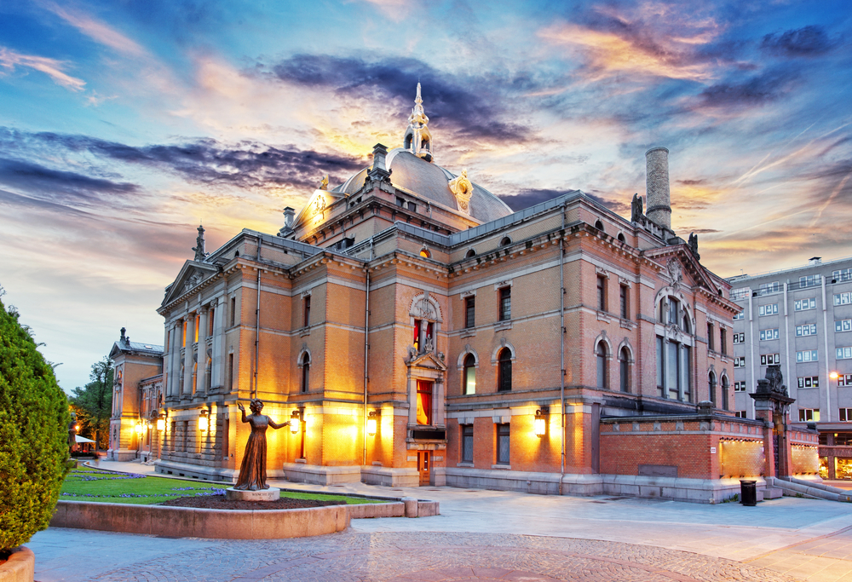
Broadening my cultural horizon is about feeling cultivated, special and ahead of the pack. The segment reflects the need to learn about a foreign culture, stand out from the crowd and break from convention. The segment is all about being proud of one’s own special ability and competence, intellectually, culturally and materially. Something to talk about when coming home.
BROADENING MY CULTURAL HORIZON
CULTIVATED, EXPLORATIVE AND AUTHENTIC
BROADENING MY KNOWLEDGE

Slide 66
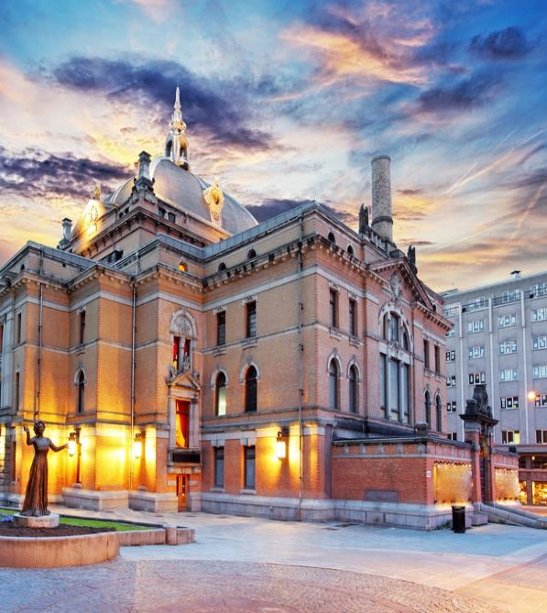
BROADENING MY CULTURAL HORIZON
Emotional benefits; What SHOULD THE HOLIDAY give me ?
The core meaning of going on holiday is to broaden my knowledge and my horizon. I want to enrich my view on the world and discover new and interesting places. All in all I want rich experiences.
Destination features and activities; What AM I looking for?
I want to go to a place with interesting culture & art and a rich cultural heritage. There must be interesting sights. The destination needs to be easy to travel to and around.
PERSONALITY; WHAT SHOULD IT STAND FOR?
The destination needs to be cultivated, explorative and authentic.
Social identity; how should it reflect upon me?
The destination should be for people who are interested to learn more. Generally people who like to explore and have new experiences.
Sometimes I need to broaden my horizon and discover new and interesting places. I want to experience culture and art at a destination with a rich cultural heritage.
44%
ARE ABOVE
60 YEARS
49%
51%
SHARE OF OVERNIGHT STAYS
12%

Slide 67
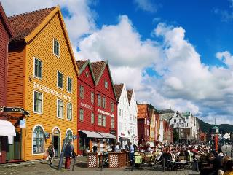
BROADENING MY CULTURAL HORIZON
TYPICAL HOLIDAY OCCASIONS
The dominant types of holiday is visits to historic sites, cultural experience (focus on art, theatre etc.), city break (cultural, shopping, Club, restaurant visits etc.), Sightseeing/round trip and holiday to experience nature, scenery and wildlife.
It’s all about broadening my horizon!
I TRAVEL TO EXPAND MY HORIZON
These consumers want to see and learn more than other travelers. They seek destinations with a rich cultural heritage. There must be interesting sights.
THE ROLE OF BRANDS
The segment is important for brands which try to position themselves as creatively individualistic, unconventional, trendy and ahead of the rest, or as a tool for consumers to express their intelligence and cultural awareness.
HOLIDAY EXPERIENCE
These consumers you will find at historical buildings/sites, they visit cities, attend sightseeing tours and discover local culture and lifestyle. They want to visit museums and experience local architecture. Local history and legends are of high interest. You will also find them in gardens/parks, at art exhibitions and concerts/festivals.
SOURCES OF INSPIRATIONS
These consumers are, more than others inspired by homepages for the destination, homepages for attractions and sites, guidebooks and catalogues or brochures.

Slide 68
BROADENING MY CULTURAL HORIZON
Core motivations
Emotional Benefits
Social Identity
Personality
Functional Characteristics
Notes:
Here it is crucial to insist on 4 things:
Stakeholders interview as per my comment on page 1: it is fundamental to understand what all users expect; it does not mean that collectively we will say yes to everything, but understanding potential challenges will help address this together
Formal deployment to make things official is also fundamental and too often forgotten: that have to be done together
We know things will not be perfect thus the importance of monitoring and adjusting the SOW if needed
It would be a big mistake to run fast in implementation: time we spend there is time we save later

Slide 69
Segment profile – BROADENING MY CULTURAL HORIZON
Significantly over indexed in segment
Significantly under indexed in segment
TYPOLOGY
TRANSPORT AND ACOMMODATION
ACTIVITIES
TYPE OF HOLIDAY
TRANSPORT TO DESTINATION
ACTIVITIES
TRANSPORT ON DESTINATION
DURATION
ACCOMMODATION
TIME OF YEAR

Slide 70
Segment profile – BROADENING MY CULTURAL HORIZON
Significantly over indexed in segment
Significantly under indexed in segment
PLANNING
DECISION MADE
INFLUENCERS
INFORMATION SOURCES
TRAVEL COMPANIONS
WHO DID YOU TRAVEL WITH
NUMBER OF TRAVEL COMPANIONS
TRAVEL FREQUENCY (NUMBER OF TIMES ABROAD)
HOW DID YOU TRAVEL

Slide 71
Exploring the world of natural beauty is about feeling unique, daring and adventurous. The segment reflects the need to see something new, something spectacular like a natural phenomenon. It also connects with the need to immerse in unspoiled nature and travel to a destination not ruined by tourism. Staying ahead of the “charter pack”. The segment is all about being proud of one’s ability to “go where no one has gone before”.
ADVENTURES IN the world of natural beauty
adventurous, daring AND unique.
immerse myself in the local life. Unspoiled nature.

Slide 72
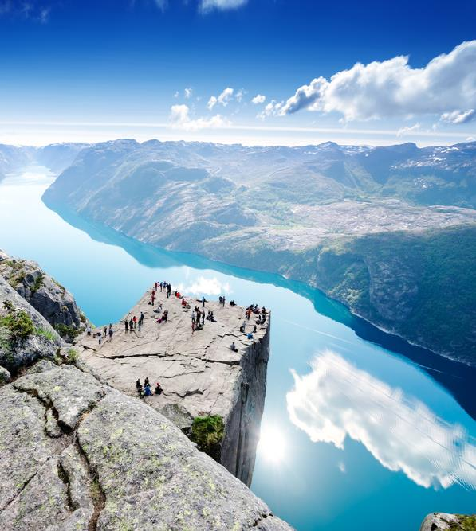
ADVENTURES IN the world of natural beauty
Emotional benefits; What SHOULD THE HOLIDAY give me ?
The core meaning of going on holiday is to broaden my knowledge and my horizon. I want to enrich my view on the world and discover new and interesting places. A place that allows me to immerse myself in the local life. All in all I want rich experiences and new inspiration.
Destination features and activities; What AM I looking for?
I want to go to a place that is not ruined by tourism. It has unspoiled nature and allow me to live close to nature. I want quiet environments and beautiful nature. A destination that has good opportunities to meet local people and also interesting sights. A rich cultural heritage would also be good.
PERSONALITY; WHAT SHOULD IT STAND FOR?
The destination needs to be adventurous, daring, unique, explorative, authentic and active.
Social identity; how should it reflect upon me?
The destination should be for people who like adventure and wants a life changing experience. People who want to make a different choice and do things the unconventional way. People who like to explore and have new experiences and are interested to learn more.
Sometimes I need to discover new and interesting places at a destination that has unspoiled nature and that s not ruined by tourism.
51%
ARE BETWEEN
30-59 YEARS
46%
54%
SHARE OF OVERNIGHT STAYS
15%

Slide 73
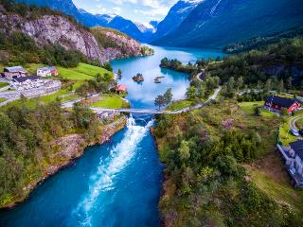
ADVENTURES IN the world of natural beauty
TYPICAL HOLIDAY OCCASIONS
The most common holiday type is a holiday to experience nature, scenery and wildlife. They are also over indexing on sport/active holiday.
I TRAVEL TO SOMETHING UNIQUE
These consumers choose destinations that makes them feel adventurous and daring. They want to experience something unique. They want to travel to places that are fuelling their explorative side.
THE ROLE OF BRANDS
The segment is important for brands which try to position themselves as creatively individualistic, unconventional, trendy and ahead of the rest, or as a tool for consumers to express their uniqueness, seeing something others has not seen. Also act as a tool for consumers to express their environmental awareness. A sustainable destination, not ruined by tourism.
HOLIDAY EXPERIENCE
This is a very active segment. They want to observe beauty of nature and natural phenomenon, discover local culture and lifestyle, experience mountains, the wilderness or the wildlife, discover local history and legends, visit the countryside and also experience national festivals and traditional celebrations.
SOURCES OF INSPIRATIONS
This segment seek their information for homepages for the destination, carriers and attractions and sights. They also use guidebooks and read reviews from other travelers online. Catalogues or brochures are also popular.

Slide 74
ADVENTURES IN the world of natural beauty
Core motivations
Emotional Benefits
Social Identity
Personality
Functional Characteristics
Notes:
Here it is crucial to insist on 4 things:
Stakeholders interview as per my comment on page 1: it is fundamental to understand what all users expect; it does not mean that collectively we will say yes to everything, but understanding potential challenges will help address this together
Formal deployment to make things official is also fundamental and too often forgotten: that have to be done together
We know things will not be perfect thus the importance of monitoring and adjusting the SOW if needed
It would be a big mistake to run fast in implementation: time we spend there is time we save later

Slide 75
Segment profile – ADVENTURES IN the world of natural beauty
Significantly over indexed in segment
Significantly under indexed in segment
TYPOLOGY
TRANSPORT AND ACOMMODATION
ACTIVITIES
TYPE OF HOLIDAY
TRANSPORT TO DESTINATION
ACTIVITIES
TRANSPORT ON DESTINATION
DURATION
ACCOMMODATION
TIME OF YEAR

Slide 76
Segment profile – ADVENTURES IN the world of natural beauty
Significantly over indexed in segment
Significantly under indexed in segment
PLANNING
DECISION MADE
INFLUENCERS
INFORMATION SOURCES
TRAVEL COMPANIONS
WHO DID YOU TRAVEL WITH
NUMBER OF TRAVEL COMPANIONS
TRAVEL FREQUENCY (NUMBER OF TIMES ABROAD)
HOW DID YOU TRAVEL

Slide 77
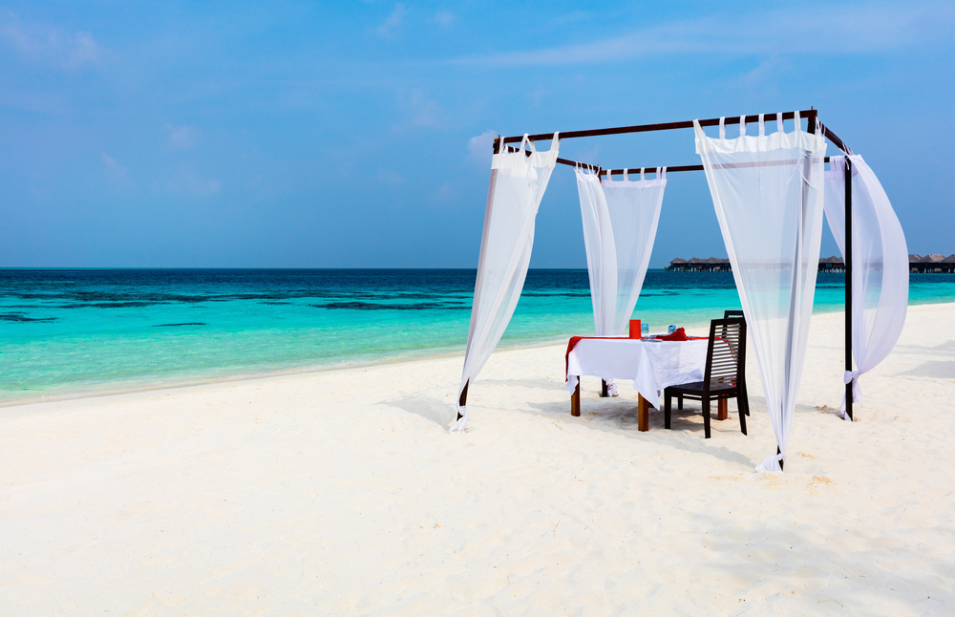
Extravagant indulgence is about the need to indulge in some luxury. Find those romantic spots that really creates a feeling of extravagance. It relates to the desire to feel on top of the world. The segment reflects that I want the best and are willing to pay for it.
EXTRAVAGANT INDULGENCE
EXTRAVAGANT AND SUPERIOR
SOPHISTICATED AND CLASSY

Slide 78
EXTRAVAGANT INDULGENCE
Emotional benefits; What SHOULD THE HOLIDAY give me ?
The core meaning of going on holiday is to allow me to indulge myself with a bit of luxury. I want a vacation that makes me feel on top of the world.
Destination features and activities; What AM I looking for?
I want to go to a place that has romantic spots. Good shopping and good service is important. I want a destination that is well organized. Of course it needs to have a variety of different restaurant offers.
PERSONALITY; WHAT SHOULD IT STAND FOR?
The destination needs to be extravagant, superior, classy and unique.
Social identity; how should it reflect upon me?
The destination should be for people who is sophisticated and classy. People who want the best and are willing to pay for it. Basically people who like to have the best things and value high quality.
Sometimes I NEED TO INDULGE MY SELF WITH A BIT OF LUXURURY AND FEEL ON TOP OF THE WORLD. I NEED A DESTINATION WITH ROMANTIC SPOTS.
56%
ARE BELOW
40 YEARS
40%
60%
SHARE OF OVERNIGHT STAYS
12%

Slide 79
EXTRAVAGANT INDULGENCE
TYPICAL HOLIDAY OCCASIONS
You will find most of the typical sun and beach vacations in this segment, but you will find ski/active holidays, cruise, health travel and culinary trips. Although, most of the time it’s all about romance!
I TRAVEL FOR ROMANCE AND LUXURY
These consumers choose destinations that enables them to indulge in a bit of luxury. Although most of the trips are in summertime it can even be in the winter. They often travel on organized tours or have others plan for them and travel independently.
THE ROLE OF BRANDS
The segment is important for brands trying to position themselves as premium, high-class and powerful. It appeals to the need to be respected and revered, to feel strong and ‘on-top-of-the-world’. It is also an important dimension for brands who want to be perceived as exclusive and only available for the lucky few.
HOLIDAY EXPERIENCE
These consumers over index on spa resorts and visits to amusements parks. They want their romantic spots which they can find both in cities and in traditional beach resorts. They often rent a car for their romantic getaways. They stay at high standard hotels more than in other segments.
SOURCES OF INSPIRATIONS
These consumers don’t spend a lot of time planning. 42% of them settle for the trip less than four weeks before they go. They get inspired by social media or articles in newspapers or magazines. They also browse the internet in general to get luxurious romantic inspiration. They travel with their partner and gets inspired by him or her.

Slide 80
EXTRAVAGANT INDULGENCE
Core motivations
Emotional Benefits
Social Identity
Personality
Functional Characteristics
Notes:
Here it is crucial to insist on 4 things:
Stakeholders interview as per my comment on page 1: it is fundamental to understand what all users expect; it does not mean that collectively we will say yes to everything, but understanding potential challenges will help address this together
Formal deployment to make things official is also fundamental and too often forgotten: that have to be done together
We know things will not be perfect thus the importance of monitoring and adjusting the SOW if needed
It would be a big mistake to run fast in implementation: time we spend there is time we save later

Slide 81
Segment profile – EXTRAVAGANT INDULGENCE
Significantly over indexed in segment
Significantly under indexed in segment
TYPOLOGY
TRANSPORT AND ACOMMODATION
ACTIVITIES
TYPE OF HOLIDAY
TRANSPORT TO DESTINATION
ACTIVITIES
TRANSPORT ON DESTINATION
DURATION
ACCOMMODATION
TIME OF YEAR

Slide 82
Segment profile - EXTRAVAGANT INDULGENCE
Significantly over indexed in segment
Significantly under indexed in segment
PLANNING
DECISION MADE
INFLUENCERS
INFORMATION SOURCES
TRAVEL COMPANIONS
WHO DID YOU TRAVEL WITH
NUMBER OF TRAVEL COMPANIONS
TRAVEL FREQUENCY (NUMBER OF TIMES ABROAD)
HOW DID YOU TRAVEL

Slide 83
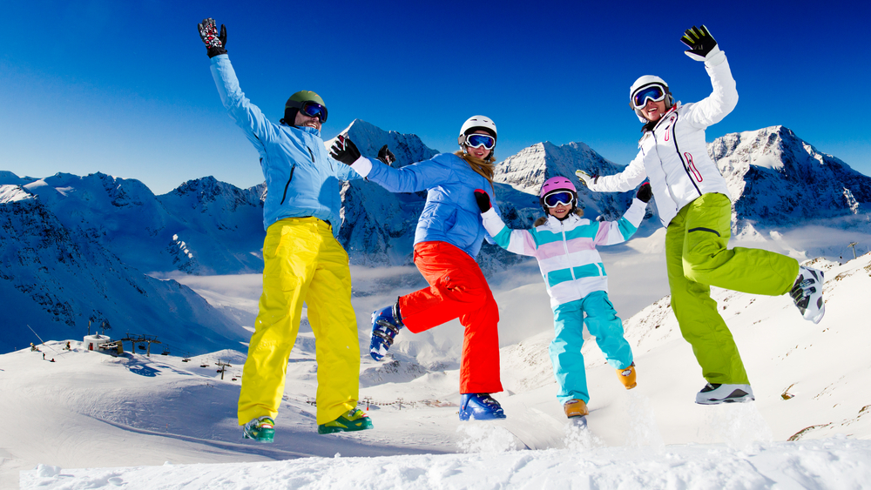
Energy is about adventure, being active, testing your boundaries and discovering new things. It taps into the need to be energized. Energy is all about being active and experiencing the freedom, passion, and adventure that comes with activities. Buzzing about, spending energy, and feeling very much alive and kicking.
ENERGY
ACTIVE AND ADVENTUROUS
HAVE AS MUCH FUN AS POSSIBLE

Slide 84
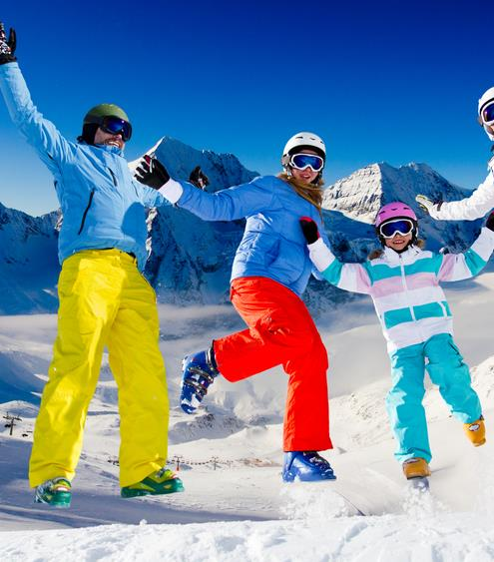
ENERGY
Emotional benefits; What SHOULD THE HOLIDAY give me ?
The core meaning of going on holiday is to feel full of energy. A holiday should give me new inspiration. Of course it should create precious moments of togetherness and help me to enjoy life to the fullest.
Destination; What AM I looking for?
I want to go to a place that offers a wide range of possible activities also for kids. A destination that allows me to be physical active.
PERSONALITY; WHAT SHOULD IT STAND FOR?
The destination needs to be active, adventurous and explorative.
Social identity; how should it reflect upon me?
The destination should be for people who want to have as much fun as possible in life, and like to do things spontaneously, impulsively. People who like adventure. People who have an active and busy social life, and who enjoy spending time with friends.
Sometimes I NEED a holiday that gives med energy and new inspiration. I need a destination with a wide range of activities that keeps me physical active.
24%
ARE BELOW
30 YEARS
48%
52%
SHARE OF OVERNIGHT STAYS
9%

Slide 85
ENERGY
TYPICAL HOLIDAY OCCASIONS
As in most segments you will find the typical sun and beach vacation in this segment, but you will also find ski/active holidays and party and fun!
I TRAVEL TO GET ENERGY
These consumers choose destinations that enables them to live life to the fullest. They often travel in larger groups (4 or more) with friends and with children, so the social element is also important. Many of them travel by car and they stay at a rented cabin/holiday home. More than in other segments they travel in wintertime.
THE ROLE OF BRANDS
The energy segment is important for brands who position themselves as vital and energetic and who are always pushing the boundaries and stimulating consumers with change and challenge. A brand that wants to adopt a Vitality strategy needs to position itself as inquisitive and curious about the world, a brand that is entertaining, surprising and sometimes perhaps even shocking for its (temporary) consumers. It is important for these brands to offer constant renewal.
HOLIDAY EXPERIENCE
More than in other segments you will find activities like hiking, winter activities (Alpine skiing/snowboarding, cross country skiing, dog-sleigh, snowmobile etc.) and visits to amusement parks. And of course they enjoy relaxation, observe beauty of nature and taste local food and drink as much as the next man.
SOURCES OF INSPIRATIONS
These consumers don’t spend a lot of time planning where to go. Most of them settle for the trip less than 2 months before they go. Their main source of information is the internet in general. I.e. it will be important to use search engines as a vehicle to reach this segment. Their children, friends and acquaintances heavily influences their choice.

Slide 86
ENERGY
Core motivations
Emotional Benefits
Social Identity
Personality
Functional Characteristics
Notes:
Here it is crucial to insist on 4 things:
Stakeholders interview as per my comment on page 1: it is fundamental to understand what all users expect; it does not mean that collectively we will say yes to everything, but understanding potential challenges will help address this together
Formal deployment to make things official is also fundamental and too often forgotten: that have to be done together
We know things will not be perfect thus the importance of monitoring and adjusting the SOW if needed
It would be a big mistake to run fast in implementation: time we spend there is time we save later

Slide 87
Segment profile – ENERGY
Significantly over indexed in segment
Significantly under indexed in segment
TYPOLOGY
TRANSPORT AND ACOMMODATION
ACTIVITIES
TYPE OF HOLIDAY
TRANSPORT TO DESTINATION
ACTIVITIES
TRANSPORT ON DESTINATION
DURATION
ACCOMMODATION
TIME OF YEAR

Slide 88
Segment profile - ENERGY
Significantly over indexed in segment
Significantly under indexed in segment
PLANNING
DECISION MADE
INFLUENCERS
INFORMATION SOURCES
TRAVEL COMPANIONS
WHO DID YOU TRAVEL WITH
NUMBER OF TRAVEL COMPANIONS
TRAVEL FREQUENCY (NUMBER OF TIMES ABROAD)
HOW DID YOU TRAVEL

Slide 89
4
BRAND PROFILE OF
Norway
Associations
Emotional benefits associated with Norway
Destination characteristics associated with Norway
Brand personality associated with Norway
Social identity associated with Norway

Slide 90
How Norway is perceived as a holiday destination
EMOTIONAL BENEFITS
DESTINATION CHARACTERISTICS
WHY do people go on holiday to Norway?
WHAT associations are related to specific destination characteristics in Norway?
BRAND PERSONALITY
SOCIAL IDENTITY
WHAT does Norway stand for?
HOW does a holiday to Norway reflect upon me?

Slide 91
EMOTIONAL associations
Norway does not have a very strong emotional footprint. It lacks a clear reason why at least outside of Sweden & Denmark. In these last two countries Norway is associated with no surprises and a safe feeling as well as energizing.

Slide 92
DESTINATION CHARACTERISTICS
People are generally very clear on what to expect in terms of functional delivery: unspoiled nature, isolated, well organized and generally safe

Slide 93
SOCIAL IDENTITY
Norway does not have a consistent strong global footprint when it comes to social identity.
For Sweden and Denmark, Norway is the destination for people who prefer the familiar over the unknown.
But across more distant markets Norway is seen as a destination for people who like adventure and to explore. People who like to have the best things, who value high quality.

Slide 94
BRAND PERSONALITY
Across most countries Norway is seen as peaceful & fresh. More distant markets see Norway as more adventurous, more for explorative people.
For Denmark and Sweden it’s more predictable & practical.
For none of the markets is Norway seen as very lively, playful or social. It’s not a place for extravagance and partying. It also lacks sophistication – not authentic, not cultivated.

Slide 95
China and to a lesser extent the USA are a bit more clueless about Norway (in general); for them it’s a very exotic destination – off the beaten track.

Slide 96
Norway’s fit to segments in all markets
A clear fit to «Exploring the world of natural beauty» in most markets
 | Broadening My Cultural Horizon | Extravagant indulgence | Escape | Adventures in the World of Natural Beauty | Sharing & Caring | Control | Energy | Playful Liberation | Social Immersion
UK | 0.22 | -0.19 | 0.23 | 0.51 | -0.35 | -0.16 | -0.07 | -0.19 | -0.06
GERMANY | 0.13 | -0.09 | 0.24 | 0.51 | -0.39 | -0.14 | -0.02 | -0.10 | -0.16
USA | 0.45 | -0.34 | 0.25 | 0.32 | -0.08 | -0.26 | -0.09 | -0.31 | 0.21
DENMARK | -0.27 | -0.22 | 0.29 | -0.24 | 0.19 | 0.50 | 0.05 | 0.02 | -0.26
SWEDEN | -0.25 | -0.15 | 0.14 | -0.09 | 0.01 | 0.54 | 0.00 | 0.04 | -0.28
CHINA | 0.07 | -0.03 | 0.14 | 0.35 | -0.27 | -0.17 | -0.05 | 0.06 | -0.24
SPAIN | 0.07 | 0.03 | 0.19 | 0.27 | -0.32 | 0.12 | -0.13 | -0.03 | -0.28
ITALY | 0.08 | -0.03 | 0.21 | 0.37 | -0.38 | -0.06 | -0.05 | 0.10 | -0.19
NETHER-LANDS | 0.09 | -0.17 | 0.28 | 0.43 | -0.25 | -0.05 | 0.13 | -0.15 | -0.19
FRANCE | 0.06 | -0.11 | 0.26 | 0.36 | -0.36 | 0.03 | -0.09 | -0.06 | -0.19
AVERAGE | 0.06 | -0.13 | 0.22 | 0.28 | -0.22 | 0.03 | -0.03 | -0.06 | -0.16
Good fit
Neutral fit
Bad fit

Slide 97
Some changes in the German market
Germans generally have much of the same association to Norway as in 2011, BUT this time Norway is seen to have more friendly people and better satisfy Germans needs to broaden their knowledge.
Norway’s personality is also seen as more cultivated and open-minded than in 2011.
Top 5 emotional benefits
Allows me to discover new and interesting places
Gives me rich experiences
Helps me to escape from my hectic daily life
Allows me to broaden my horizon
Allows me to broaden my knowledge
Top 5 destination characteristics
Has beautiful nature
Allows me to live close to nature
Is not too warm
Has unspoiled nature
Has friendly people
Top 5 personality items
Friendly
Peaceful
Authentic
Active
Cultivated and Open-minded

Slide 98
Some changes in the Dutch market
The Dutch have the same emotional and functional association to Norway as in 2011.
BUT Norway’s personality has evolved. Norway is seen as more relaxed, daring, authentic and friendly than in 2011.
Top 5 emotional benefits
Allows me to discover new and interesting places
Gives me rich experiences
Helps me to escape from my hectic daily life
Allows me to broaden my horizon
Enriches my view on the world
Top 5 destination characteristics
Has beautiful nature
Has unspoiled nature
Has quiet environments
Is not too warm
Allows me to be physical active
Top 5 personality items
Active
Adventurous
Peaceful
Relaxed
Daring, Authentic and Friendly

Slide 99
5
The competitive
Landscape
Visits and repeat visits
Strengths and weaknesses

Slide 100
Norway's ANCHOR POINT in the
THE NORWAY BRAND POSITIONING ANCHOR POINT
category Frame suggest a close
connection To the green dimension
Hence at a global level Innovation Norway should focus their effort
on the south cone of the frame
WHAT THIS WILL TELL YOU:
Them most common association to Norway is, for most of the markets, related to the needs in the green dimension.
There will be local market differences so please refer to local country reports, when assessing Norway’s position in each specific market.

Slide 101
Looking outside Norway’s traditional
THE NORWAY BRAND POSITIONING ANCHOR POINT
Competitive space, you will find other
Destinations competing for the same needs
WHAT THIS WILL TELL YOU:
There are the traditional “winter” competitors like Canada.
But you also have many destinations in Africa, South America and South East Asia competing for the same position as Norway.

Slide 102
Overview Destinations
Perfect fit (>0,60)
Good fit (0,10 to 0,60)
Neutral fit (-0,10 to 0,10)
Negative fit (-0,20 to -10)
Very negative fit (<-0,20)
 | Broadening My Cultural Horizon | Extravagant indulgence | Escape | Adventures in the World of Natural Beauty | Sharing & Caring | Control | Energy | Playful Liberation | Social Immersion
Austria | 0,03 | -0,04 | 0,07 | -0,25 | 0,08 | 0,30 | -0,08 | -0,08 | -0,19
Canada | -0,06 | 0,00 | 0,03 | 0,34 | -0,29 | 0,04 | 0,10 | -0,04 | -0,12
China | 0,26 | 0,11 | -0,25 | 0,36 | -0,37 | -0,14 | -0,06 | -0,14 | 0,05
Croatia | -0,10 | -0,28 | 0,29 | -0,13 | 0,29 | -0,13 | 0,06 | 0,06 | 0,13
Czech Republic | 0,24 | -0,19 | -0,10 | -0,14 | 0,10 | 0,07 | -0,04 | 0,00 | 0,17
Denmark | 0,08 | -0,14 | 0,11 | -0,14 | 0,06 | 0,25 | -0,15 | -0,05 | -0,02
Finland | 0,03 | -0,14 | 0,22 | 0,22 | -0,17 | 0,06 | -0,05 | -0,01 | -0,15
France | 0,09 | 0,32 | -0,15 | -0,48 | 0,13 | 0,12 | -0,16 | -0,01 | -0,13
Germany | 0,08 | 0,09 | -0,30 | -0,42 | 0,05 | 0,64 | -0,17 | -0,08 | -0,15
Iceland | 0,03 | -0,11 | 0,17 | 0,61 | -0,40 | -0,21 | 0,12 | 0,00 | -0,14
Italy | 0,02 | 0,15 | -0,06 | -0,45 | 0,25 | -0,07 | -0,08 | 0,11 | 0,04
Netherlands | 0,16 | -0,16 | -0,15 | -0,25 | 0,11 | 0,24 | -0,04 | 0,03 | 0,17
New Zealand | -0,07 | 0,02 | 0,10 | 0,63 | -0,43 | -0,27 | 0,19 | 0,00 | -0,13
Norway | 0,06 | -0,13 | 0,22 | 0,28 | -0,22 | 0,03 | -0,03 | -0,06 | -0,16
Portugal | -0,06 | -0,20 | 0,14 | -0,35 | 0,40 | 0,01 | -0,01 | 0,05 | 0,17
Scotland | 0,17 | -0,33 | 0,23 | 0,31 | -0,09 | -0,12 | -0,02 | -0,12 | 0,06
South Africa | 0,08 | 0,02 | -0,04 | 0,57 | -0,32 | -0,34 | 0,06 | -0,10 | 0,04
Spain | -0,20 | -0,04 | 0,02 | -0,48 | 0,37 | 0,12 | 0,10 | 0,22 | 0,05
Sweden | 0,05 | -0,06 | 0,17 | 0,06 | -0,10 | 0,16 | -0,14 | -0,06 | -0,11
Switzerland | -0,05 | 0,32 | 0,03 | -0,21 | -0,10 | 0,33 | -0,18 | -0,09 | -0,37
Thailand | -0,17 | 0,01 | 0,15 | 0,10 | 0,02 | -0,34 | 0,14 | 0,20 | 0,11
Turkey | -0,03 | -0,13 | -0,03 | -0,06 | 0,19 | -0,12 | 0,17 | 0,01 | 0,10
USA | -0,07 | 0,42 | -0,49 | -0,02 | -0,28 | 0,05 | 0,21 | 0,10 | -0,11

Slide 103
6
Conclusion and recommendations
Brand positioning

Slide 104
The task at hand
The strategy to make Norway occupy a unique and credible position, relative to competing destinations, in the mind of the tourist.

Slide 105
In CONCLUSION …
Norway needs to diversify it's relevance
as a holiday destination
1
2
3
4
We have 9 decent size segments today
There are important differences by market
Highly relevant for one segment
Relevance for aditional 5 segments
Competitive destinations too are playing on multiple needs
Nature is a highly competitive area
Norway is already associated with a wide variety of holiday needs & activities
The whole of Norway, the whole year round
We see a further fragmentation of needs in the holiday segmentation
Norway connects reasonably well with multiple needs
It's the only way to stay competitive
Norway has a lot to offer

Slide 106
We see a further fragmentation of holiday needs
1
We have 9 decent size segments today (vs only 5 >6% in 2011)

Slide 107
We see a further fragmentation of holiday needs
1
There are a lot of differences in size by market
TOP 3 (% overnight stays*)
US
UK
Denmark
Sweden
China
Spain
Italy
Nether-lands
France
Germany
GLOBAL
26%
19%
9%
13%
12%
13%
14%
11%
14%
19%
10%
13%
17%
12%
21%
12%
17%
16%
15%
10%
13%
14%
21%
12%
13%
18%
18%
14%
14%
22%
19%
14%
15%
24%
23%
16%
13%
12%
9%
* Share of overnight stays: The segment volume is derived from the number of overnight stays on each occasion. The figures on the slide shows the share of overnight stays on all holidays.

Slide 108
Norway connects well with multiple needs
2
Highly relevant for one segment, decent relevance for additional 5 segments
EXTRAVAGANT INDULGENCE
ADVENTURES IN THE WORLD OF NATURAL BEAUTY
Fit with segments

Slide 109
Diversification is necessary to stay competitive
3
Nature is a highly competitive area
ADVENTURES IN the world of natural beauty
Fit with Exploring the World of Natural Beauty

Slide 110
Diversification is necessary to stay competitive
3
Competitive destinations too are playing on multiple needs

Slide 111
Diversification is necessary to stay competitive
3
Competitive destinations too are playing on multiple needs
Notes:
Playing on many different segments
Eg fika = social immersion
Relaxing
Exploring nature
Broadening
Energy

Slide 112
Norway has a lot to offer
4
Norway is used for a wide variety of holiday needs & activities
Base: holidays to Norway

Slide 113
Norway has a lot to offer
4
This fits with the ambition to promote “the whole of Norway, the whole year round”

Slide 114
Recommendations
Where do we go from here?
Notes:
Still a bit early to have digested all of this, but some first, broad recommendations can already be formulated.

Slide 115
Looking at Norway’s current strengths
And position different routes that can be explored
POSSIBLE ADDITIONS
CONTROL
Especially for Sweden and Denmark, but not alone. I has to be in combination with another segment motivation.
SOCIAL IMMERSION
Important for city breaks.
THE OBVIOUS TARGET
BROADENING MY CULTURAL HORIZON
Especially for the US this is an important segment; Norway already delivering.
SHARING & CARING
Norway already has a decent fit in Denmark.
ADVENTURES IN the world of natural beauty
ESCAPE
For many travelers Nordic destinations are seen as destinations to escape. Why can’t Norway be a place to escape when Sweden and Denmark can?
Extravagant Indulgence
An important segment in China & US.
ENERGY
No destination seems to be especially strong in this segment. It’s a white space.
PLAYFUL LIBERATON
An important segment in China & Italy.

Slide 116
Norway Needs to continue to work on Holiday basics
Norway fails to meet some basic holiday expectations in the category, i.e. across segments globally
IMPROVE/BE MORE OF
SUSTAIN PERFORMANCE
Good value for money
Interesting, rich cultural heritage or art
Beautiful nature
Social, friendly
Good local cuisine
Peaceful
For Explorers
Maintain
Improve

Slide 117
Targeting «ADVENTURES IN the world of natural beauty»
Norway needs to get more emotional on a global scale
Strengthen the emotional benefits
Destination features are strong
Resonate better with the global tourist
Norway has a very weak emotional position in this segment. Focus on providing rich experiences and the discovery of new and interesting places.
Maintain and develop
Maintain everything that has to do with nature and environment/sustainability.
Develop the association to interesting sights and the possibility to meet local people.
Weak social identity
Personality associations are slim
Strengthening is needed
Strengthen the perception of Norway as a destination for people who like adventure and focus on creating a life changing experience.
Create one that is more relevant
Keep on maintaining “Fresh” and “Active”. Become more “Adventurous” and “Daring”.

Slide 118
Questions?
Please contact…
Kjetil Strømseth
kjetil.stromseth@ipsos.com
Oslo
+47 934 52 000
Steven Naert
steven.naert@ipsos.com
Antwerp
+ 32 497 70 64 57

