Slide 1
Global Outreach -
Local Focus
Engineering Creative Solutions to Global Challenges
Notes:
To use this title animation slide with a new image simply 1) move the top semi-transparent shape to the side, 2) delete placeholder image, 3) click on the picture icon to add a new picture, 4) Move semi-transparent shape back to original position, 5) Update text on slide.

Slide 2
“Sustainable development is development that meets the needs of the present without compromising the ability of future generations to meet their own needs”
—Bruntlund Commission, 1987

Slide 3
By 2050, 33 billion MT of plastic are likely to be produced, with approximately 12.2 billion disposed of as waste, 3.9 billion mismanaged on land, and 0.6-1.6 billion MT eventually entering the oceans!
FACTS

Slide 4
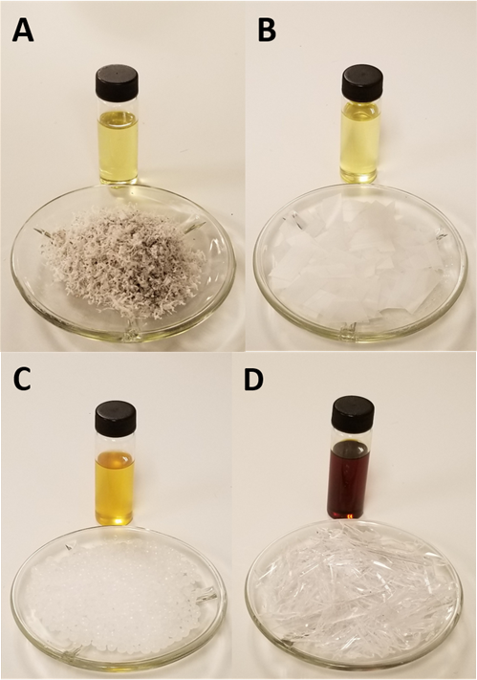
The Trash to Tank (T³) Concept
Thermal Decomposition
Plastics like grocery bags, milk jugs and cutlery can be decomposed by heat into an oil similar to diesel fuel or kerosene.
It really is that easy!

Slide 5
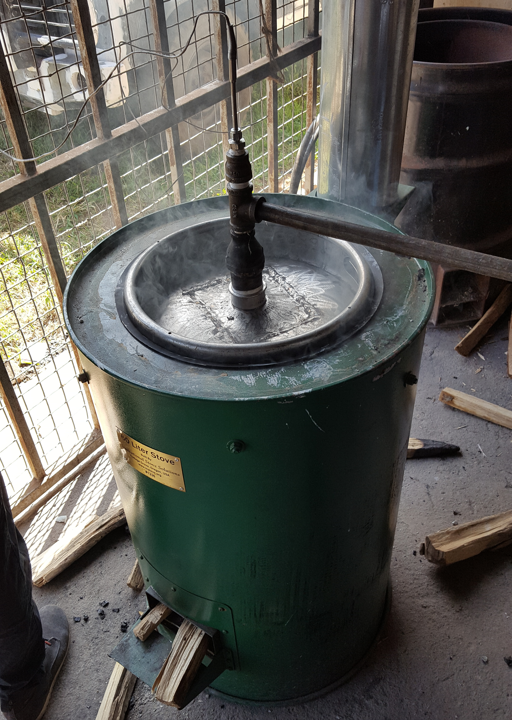
So, How Does it Work?
A One-Step Process
The fuel produced can be directly used in a diesel engine without further processing.
A wood fired retort is all we need!
This project has been funded with support from the Paducah Rotary Club.

Slide 6
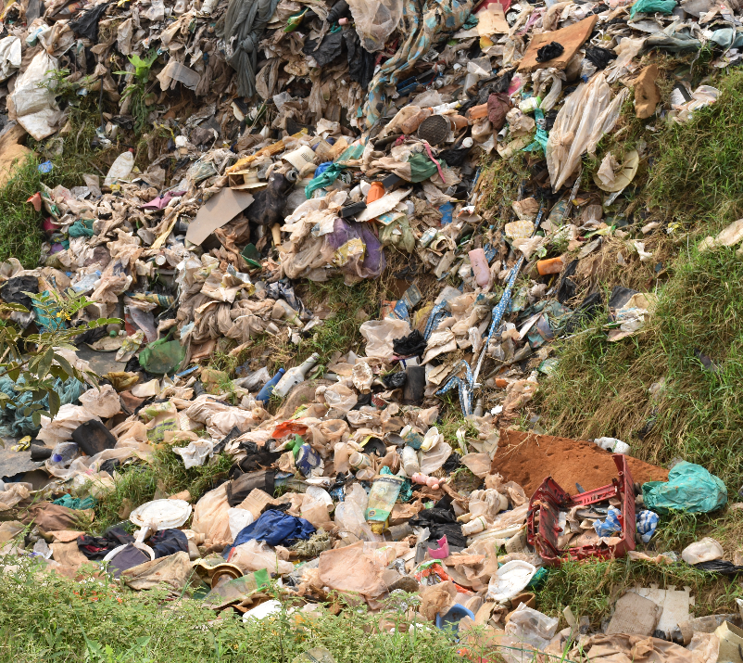
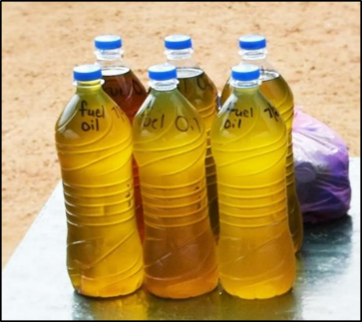
Trash to Tank – The T³ Concept
People
Clean communities and oceans free from plastic benefit all of us. Remember, we all share one planet!
What are the potential benefits of the T³ process?
Prosperity
The T³ concept can easily be turned into a business opportunity, providing much needed jobs and income to economically disadvantaged regions.
Planet
Fuel produced from waste plastic produced fewer greenhouse gases than petroleum fuels and is sulfur free.

Slide 7
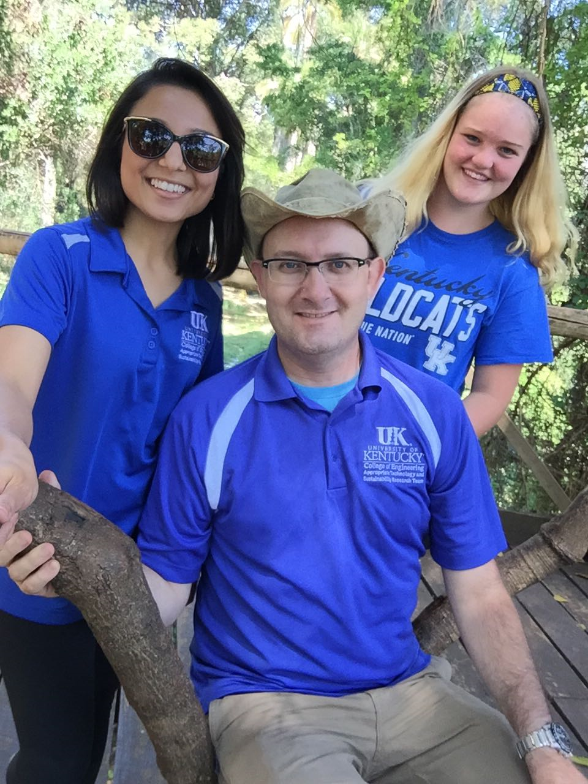
Sustainable Solutions
Impacting People, Prosperity and the Planet
Global Outreach
Globally active research impacting communities
Local Focus
Local students, from the Paducah Area!
Notes:
Combine an image and multiple key statements with a strong grid.

